Slide 1


Co-design of a return-to-work toolkit for employers and stroke survivors
August 2023: Workshop 1
Kristelle Craven
Kristelle.craven1@nottingham.ac.uk

Slide 2
Session agenda
Introductions
(15 mins)
Presentation of needs assessment findings
(10 mins)
Group task 1: Decide on priority areas and overarching goal of toolkit (40 mins)
Group task 2: Decide on determinants to be targeted (20 mins)
A determinant is anything that influences a person’s behaviour (e.g., their knowledge) or the environmental conditions (e.g., workplace resources)

Slide 3

Introductions
Notes:
Activity duration: 15 mins

Slide 4
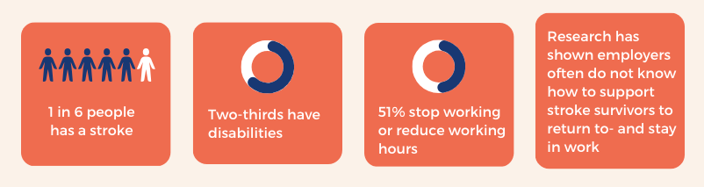
Project rationale and aim
Freely available, evidence-based resources containing practical aids for employers are scarce
Main aim of project: Work with stakeholders to co-design a toolkit resource to help stroke survivors and employers plan and manage a sustainable return to work post-stroke

Slide 5
Needs assessment: Aims
What we wanted to find out…
Which employers would most benefit from the toolkit resource?
How would employers and stroke survivors like toolkit content to be presented?
What helps or hinders an employer in supporting a stroke survivor to return to work post-stroke?

Slide 6
Needs assessment: Methods
What we did…
Systematic review of 23 published studies conducted worldwide (with 9 focusing on employers of people with acquired brain injuries)
Online survey of 50 employers
7 interviews with stroke survivors, employers and occupational therapists who support stroke survivors to return to work
Employers defined as anyone in an occupational role involving staff responsibility (e.g., supervisor, manager, HR, Occupational Health, business director)

Slide 7
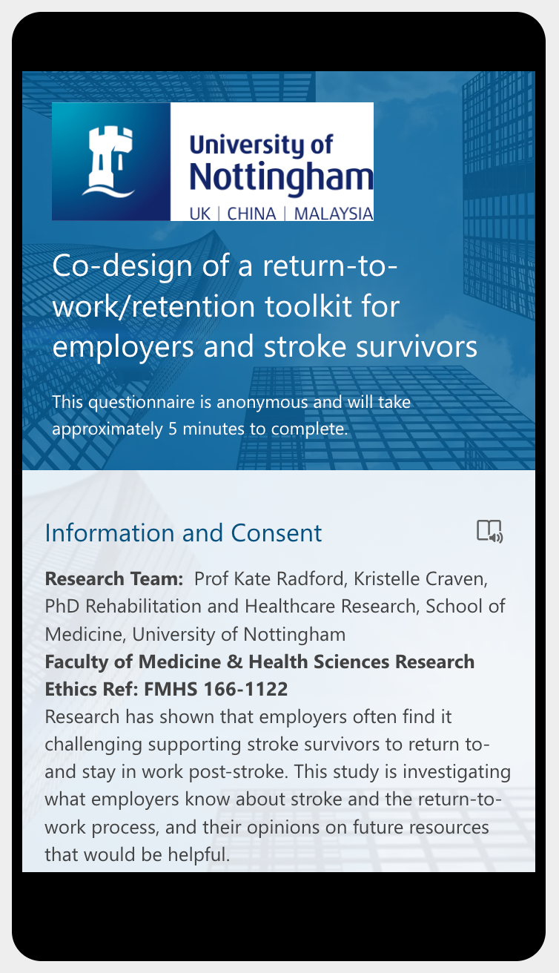
Needs assessment: Results (1)
Online survey: Characteristics of the respondents
Online survey of 50 employers
Mix of managers (38%), business owners (12%), occupational health physicians (10%), and other roles (40%)
Age range: 26-55+, 60% female, 50% with experience of post-stroke return to work
Based in health/social care (44%), manufacturing (20%), or other industries (36%)

Slide 8
Needs assessment: Results (2)
Interviews: characteristics of interviewees
Stroke survivors: NHS dental nurse, physiotherapist/business owner, HR director
Employers: NHS line manager, HR officer
Occupational therapists, specialising in neuro-rehabilitation
Organisational settings discussed: NHS dental clinic, therapy business offering rehabilitative services, NHS radiology department, fiberglass factory, car dealership, warehouse, charity for disabled people, hospitality and tourism business, education service within prison

Slide 9
Needs assessment: Results (statistical analyses) (3)
Which employers need guidance, and on what?
Employers with no HR/Occupational Health (OH) support need education on stroke and actions to take during the return-to-work process.
Small and medium-sized enterprises may benefit from education on return-to-work process actions (e.g., how to do a work trial, how to plan a return to work).
Employers with no past experience of post-stroke return to work may have lower perceived competency for carrying out supportive actions to facilitate return to work; these employers may also benefit from education on stroke.
These educational needs also shown in review and interviews; HR/OH personnel sometimes would have benefitted from education also

Slide 10
Needs assessment: Synthesis of all results (4)
Problem/s caused
Problematic behaviours of employers
Stroke survivor not trusted to have a workload
(significantly hindering return to work)
Stroke survivor not given supervisory support when needed (also expected to complete return-to-work process in 4 weeks)
1. Occupational Health/managing director’s fear of causing another stroke, under-estimation of stroke survivor’s abilities.
HR staff over-estimated stroke survivor’s abilities
2. Employer showed hesitation over accommodations to support stroke survivor
Longer return-to-work process for stroke survivor, employer felt stressed
3. Inadequate support given to a stroke survivor with emotional lability and volatility
Stroke survivor suspended for 6 months over altercation with agency worker on night shift
4. Unable to carry out difficult conversations with stroke survivor, relied on NHS OT to carry out the conversations instead
Uncertain whether these conversations would have taken place without OT’s support
5. Occupational health staff and managing director did not keep stroke survivor informed about return-to-work plans
Stroke survivor felt anxious about paying bills, and return to work felt impossible

Slide 11
Needs assessment: Synthesis of all results (5)
Problematic behaviours or environmental conditions relating to stroke survivors, employers, and co-workers
Problem/s caused
Stroke survivors left feeling shamed, invalidated, and wanting to isolate selves from co-workers. Self-employed stroke survivor had increased workload due to co-worker leaving her business.
6. Co-workers showed frustration with stroke survivors when attempting to support them. Also made comments about stroke survivor age.
E.g., One stroke survivor had too-large workload. Necessary accommodations not made.
7. Stroke survivor did not disclose needs to employer
8. Stroke survivor rushed to return to work too soon
Return to work negatively impacted. Studies have linked this to anxiety/depression.
9. Stroke survivor did not engage with employer
Line manager stressed due to lack of communication from stroke survivor
10. Organisational changes during a stroke survivor’s absence (e.g., staffing, procedure, structure) meant stroke survivors had to return to work in unsuitable, alternative roles, or a new worksite location.
Stroke survivors and management staff experienced increased stress and challenges during return-to-work process
Line manager experienced lack of support due to other teams being short staffed, stroke survivors felt isolated and unsupported, struggled with online meetings due to visual fatigue and hearing issues
11. COVID-19 caused short staffing and meant that adaptations to working practices required, e.g., all meetings held online.

Slide 12
Workshop task 1 (Selecting priority areas)
Other stakeholders
Co-workers’ frustration or unhelpful comments
Environment
Organisational changes during stroke survivor’s absence
Employers
Under/over-estimated stroke survivor’s abilities
Hesitated over accommodations
Inadequate support for emotional lability
Unable to carry out difficult conversations
Did not keep stroke survivor informed about plans
Stroke survivor did not disclose limitations
Stroke survivor rushed to return to work
Stroke survivor did not engage with employer
COVID-19: Online meetings, short staffing
Which behaviours or environmental conditions were most concerning?
Do you have anything to add?
[10 mins group discussion]
Notes:
Task duration: 20 mins

Slide 13
Workshop task 1 (Selecting priority areas)
Which three behaviours or environmental conditions should the toolkit focus on? (multiple-choice poll exercise)
How would you rate their importance? (ranking exercise)
[10 mins]
Notes:
Duration: 10 mins

Slide 14
Workshop task 1 (Deciding the aim of the toolkit)
Based on the three behaviours/environmental factors selected, what should the toolkit’s overarching aim be?
[open discussion in breakout rooms – 10 mins, then feed back to rest of group] [10 mins]
[Total: 20 mins]

Slide 15
Workshop task 2: Selection of determinants
Based on the three behaviours/environmental factors selected, which determinants should we target? (see next slide)
Are there any you would like to add? [20 mins]
A determinant is anything that influences a person’s behaviour (e.g., their knowledge) or the environmental conditions (e.g., workplace resources)

Slide 16
Workshop task 3: Selection of determinants
Determinant/s | Problematic behaviours or environmental factors
1. Employers lacked knowledge of stroke causes and impact | Employers under- and over-estimated stroke survivors’ abilities
2. Employers lacked knowledge of responsibilities according to legislation/organisational policy | E.g., Employer showed hesitation over accommodations to support stroke survivor
3. Employers lacked knowledge/skill for responding to challenging behaviours | E.g., Inadequate support given to stroke survivor with emotional lability and volatility
4. Employers lacked knowledge/skill for difficult conversations with stroke survivors | E.g., NHS OT had to carry out conversation instead
5. Employers and stroke survivors not aware of importance of staying in touch | E.g., Stroke survivor not kept informed of return-to-work plans, line manager (another case) stressed due to lack of engagement from stroke survivor
6. Co-workers did not understand or have empathy for stroke survivor and their residual limitations | Co-workers made negative comments and showed frustration with stroke survivors
7. Stroke survivors feared highlighting limitations to employer | Stroke survivor did not disclose needs to employer
8. Stroke survivors’ personal motivation to return to work (e.g., financial pressure) | Stroke survivor rushed to return to work too soon
9. Changes within organisation during stroke survivor’s absence | Stroke survivors had to return to work in unsuitable, alternative roles, or a new worksite location
10. COVID-19 (e.g., new working practices) | Short staffing, meetings all online

Slide 17
Thank you for taking part!
kristelle.craven1@nottingham.ac.uk
@CravenKristelle

