Slide 1



Advisory group meeting: Feedback on TTEAM prototypes
20th September 2024
Kristelle Craven
Occupational Therapist & PhD student
@CravenKristelle

Slide 2
Agenda
Introductions
Brief overview of TTEAM
Discussion
Question time
Notes:
(high workloads, inadequate work accommodations, environments and policies)

Slide 3

Introductions
Notes:
(high workloads, inadequate work accommodations, environments and policies)

Slide 4
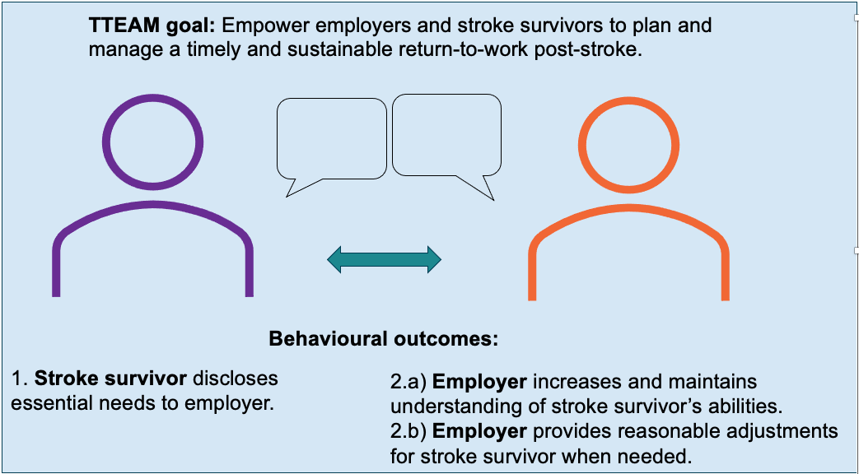
Overview of TTEAM

Slide 5
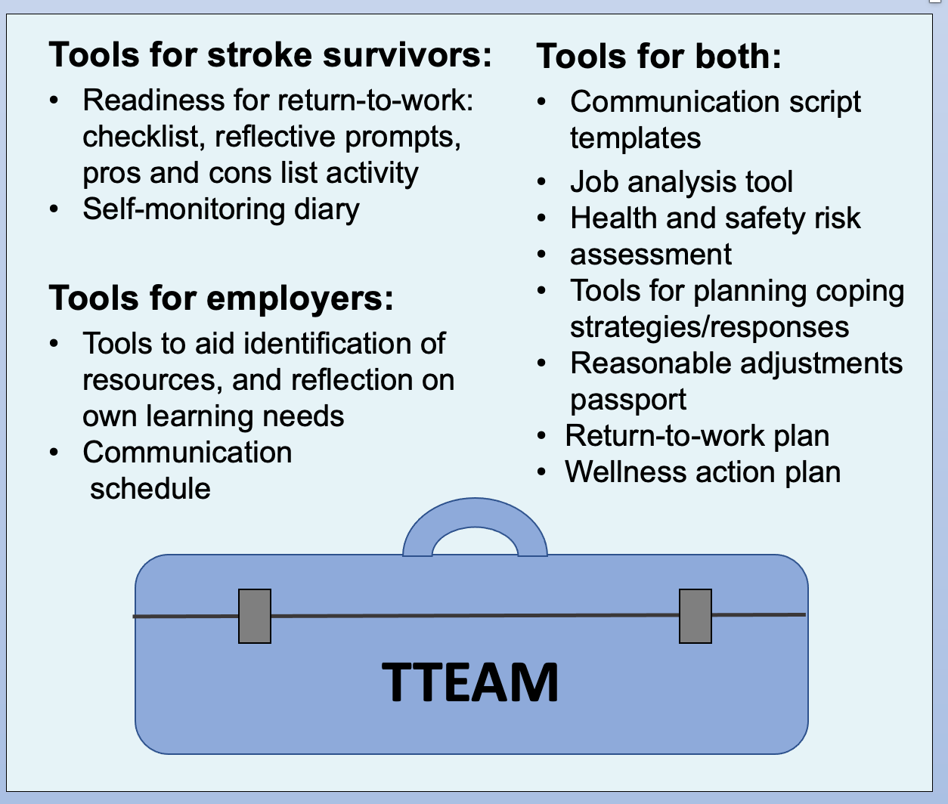
Tools included

Slide 6
Discussion

Slide 7
Questions 1 and 2
Devices used to access TTEAM?
Prototype/s accessed?:
  Stroke survivor version
  Employer version
  Both
Notes:
Note down answers next to initials of each attendee

Slide 8
Question 3
Anything that was helpful when accessing and navigating TTEAM?

Slide 9
Question 4
Anything that made it difficult to access and navigate TTEAM?

Slide 10
Question 5
Anything about TTEAM that was useful for learning about
stroke and returning to work?

Slide 11
Question 6
If you have an impairment/disability, was there anything you:
  liked about TTEAM (in relation to your needs)?
  did not like about TTEAM (in relation to your needs)?

Slide 12
Question 7
Could anything be changed to improve TTEAM?

Slide 13
Question 8
How should people be made aware of
and gain access to TTEAM?

Slide 14
Final discussion
Is there anything else you would like to say (or ask)?

Slide 15
Thank you!

Slide 16
Disclaimer
This study is funded by the Ossie Newell Foundation (ONF) and the National Institute for Health and Care Research (NIHR) Applied Research Collaboration East Midlands (ARC EM). The views expressed are those of the authors and not necessarily those of the ONF, NIHR or the Department of Health and Social Care.

