Slide 1
PhD Project: Co-design of a toolkit for employers of stroke survivors
Advisory group meeting
September 2022
Kristelle Craven, PhD student
@CravenKristelle

Slide 2

Introductions

Slide 3

Project brief (1)
Issues with employer support for stroke survivors
Many employers do not have access to expert advice to support stroke survivors in their return-to-work (RTW) (4)
RTW barriers among stroke survivors: (5-8)
  Limitations in employer knowledge
  High workloads
  Inadequate work accommodations, environments and policies
Notes:
Employers themselves reported the barrier regarding their knowledge

Slide 4

Project brief (2)
Evidence supporting use of self-guided, ‘toolkit’ interventions
Increasing number of self-guided interventions focus on RTW process, e.g., cancer (11, 12) and mental illness (13)
Evidence for their cost-effectiveness (14)
and clinical effectiveness (13)
Acceptable and useful to employers (15, 16)

Slide 5



Project brief (2)
What is a ‘toolkit’?
Collection of tools with specific focus on
single audience (9)
Toolkit resources can include: (10)
Educational materials
Assessment tools
Planning tools (e.g., checklists,
meeting agenda templates
Help translate evidence into practice (9)

Slide 6
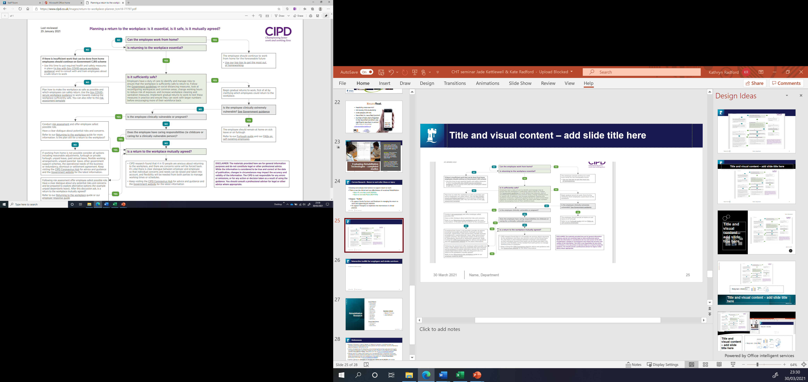
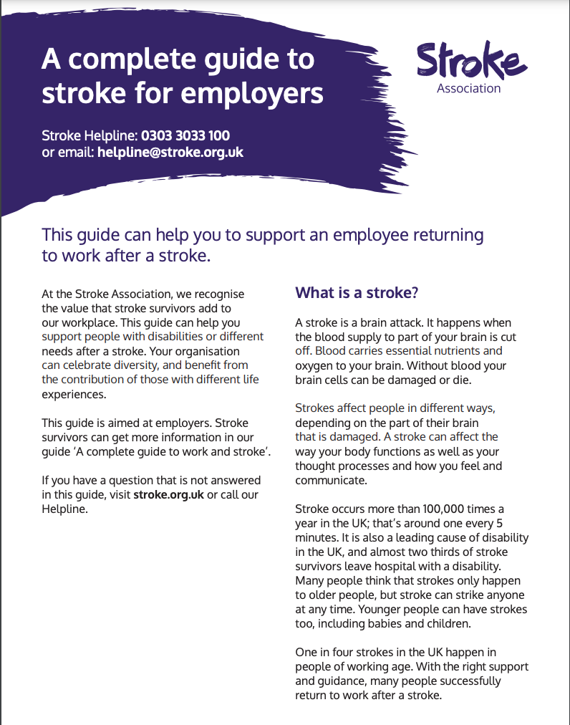
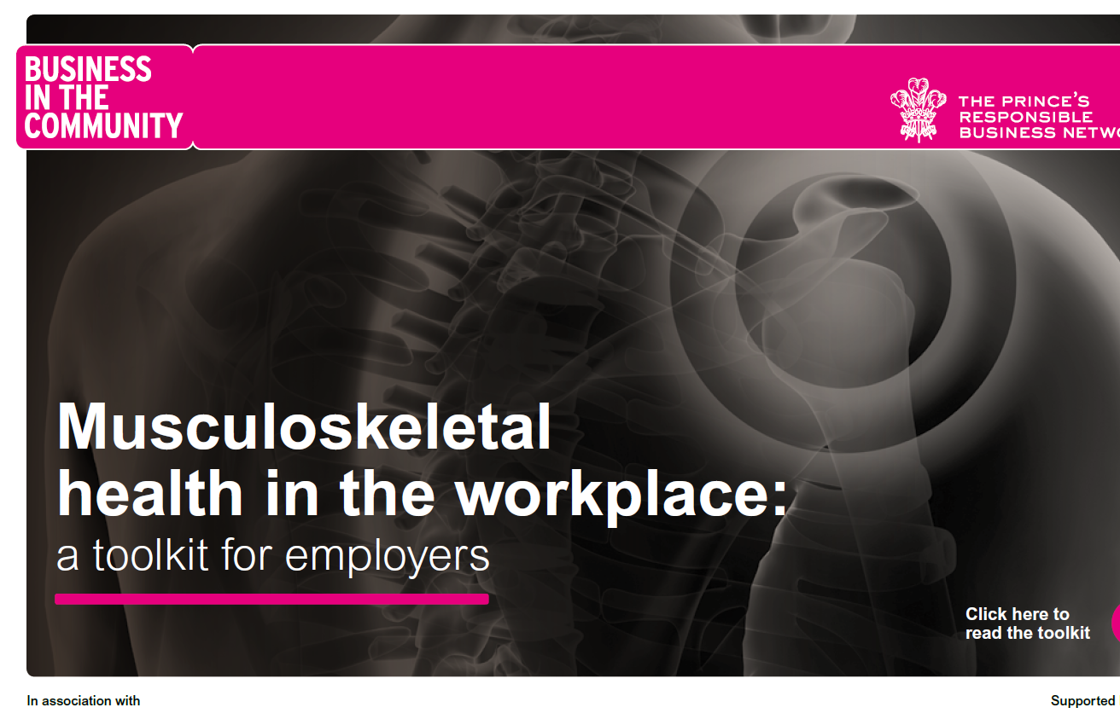
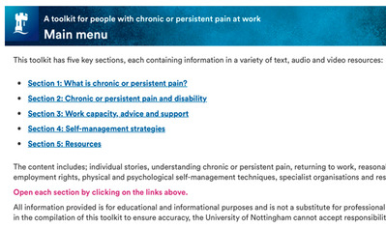

Project brief (3)
Examples of pre-existing toolkits
Notes:
Web-based resources – e-learning, links to forms, planning tools, videos, legal guidance, checklists, decision making tools
Manuals and guides to assist healthcare professionals in assessing/ rehabilitating patients and advising employers in a return to work
Booklets targeted at the person with the health condition, found a couple that target employers of stroke survivors
Workbooks & slide sets targeted at upskilling and influencing employer change

Slide 7
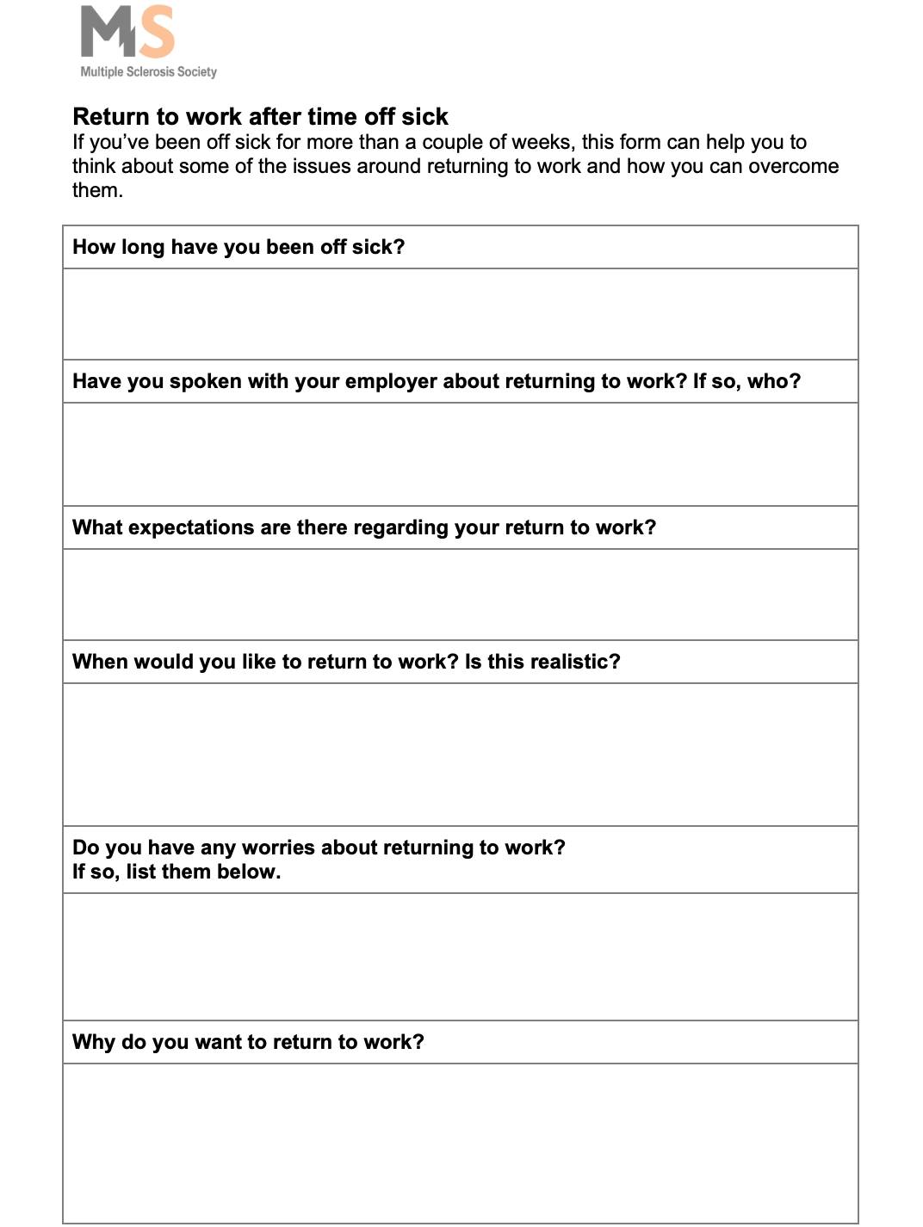
Project brief (5)
Why is a toolkit needed for employers of stroke survivors?
Health professional input not always available (17)
Toolkits aimed at stroke survivors, not employers
Employer-focused resources lengthy
Lack practical aids
Notes:
Only 1/3 of NHS trusts commissioned VR services in 2015
Health professionals not always confident to engage with employers, do not always see it as being within their professional remit, or may be restricted by consent and confidentiality issues
Example of practical aid -

Slide 8

Project brief (6)
Project aims
1) Assess the needs of employers
2) Co-design and develop a toolkit
3) Describe how the toolkit might work
Notes:
Systematic review, survey and interviews to look at what employers feel they need support with, which employers would benefit most from a toolkit, and barriers/facilitators they feel could affect its implementation in their organization
Three workshops with employer stakeholders to co-design and develop toolkit
Describe underlying mechanisms of toolkit, and how it could be introduced within the UK
*For aims 2 and 3 feedback will also be gained from a group of stroke survivors and the advisory group, in addition to the employer participants

Slide 9
Advisory group role
Planned input
Date | Objective
September 2022 | Discuss what the toolkit might look like
August 2023 | Provide feedback on: Logic model showing how the toolkit may work Proposed strategies for introducing the toolkit in the UK
August 2024 | Review toolkit prototype and provide feedback
Now – February 2025 | Members may be contacted 1:1 for specialist advice

Slide 10
Progress summary: systematic review findings
Barriers affecting employer support for employees with acquired brain injuries
Unaware employee experiencing difficulties with work performance
Lack of knowledge about ABI and impact on abilities
Lack of knowledge/skill needed for supportive actions for RTW and retention
Belief that employee (with ABI) presence and work accommodations might jeopardise health and safety of co-workers
Person with brain injury
Inadequate communication from health professionals regarding diagnosis and treatment
Lack of support from superiors or other staff (e.g., HR)
Some work accommodations reduce productivity and damage financial status of organisation
Changes within organisation during employee absence (procedures, clientele, computer software, reorganisation of roles) can hinder employee RTW
Not aware of impact of residual disabilities on work abilities
Too driven; overexert self or put pressure on self to RTW early
Employer
Environmental factors
22/09/2022
Kristelle Craven
Centre for Rehabilitation & Ageing Research

Slide 11
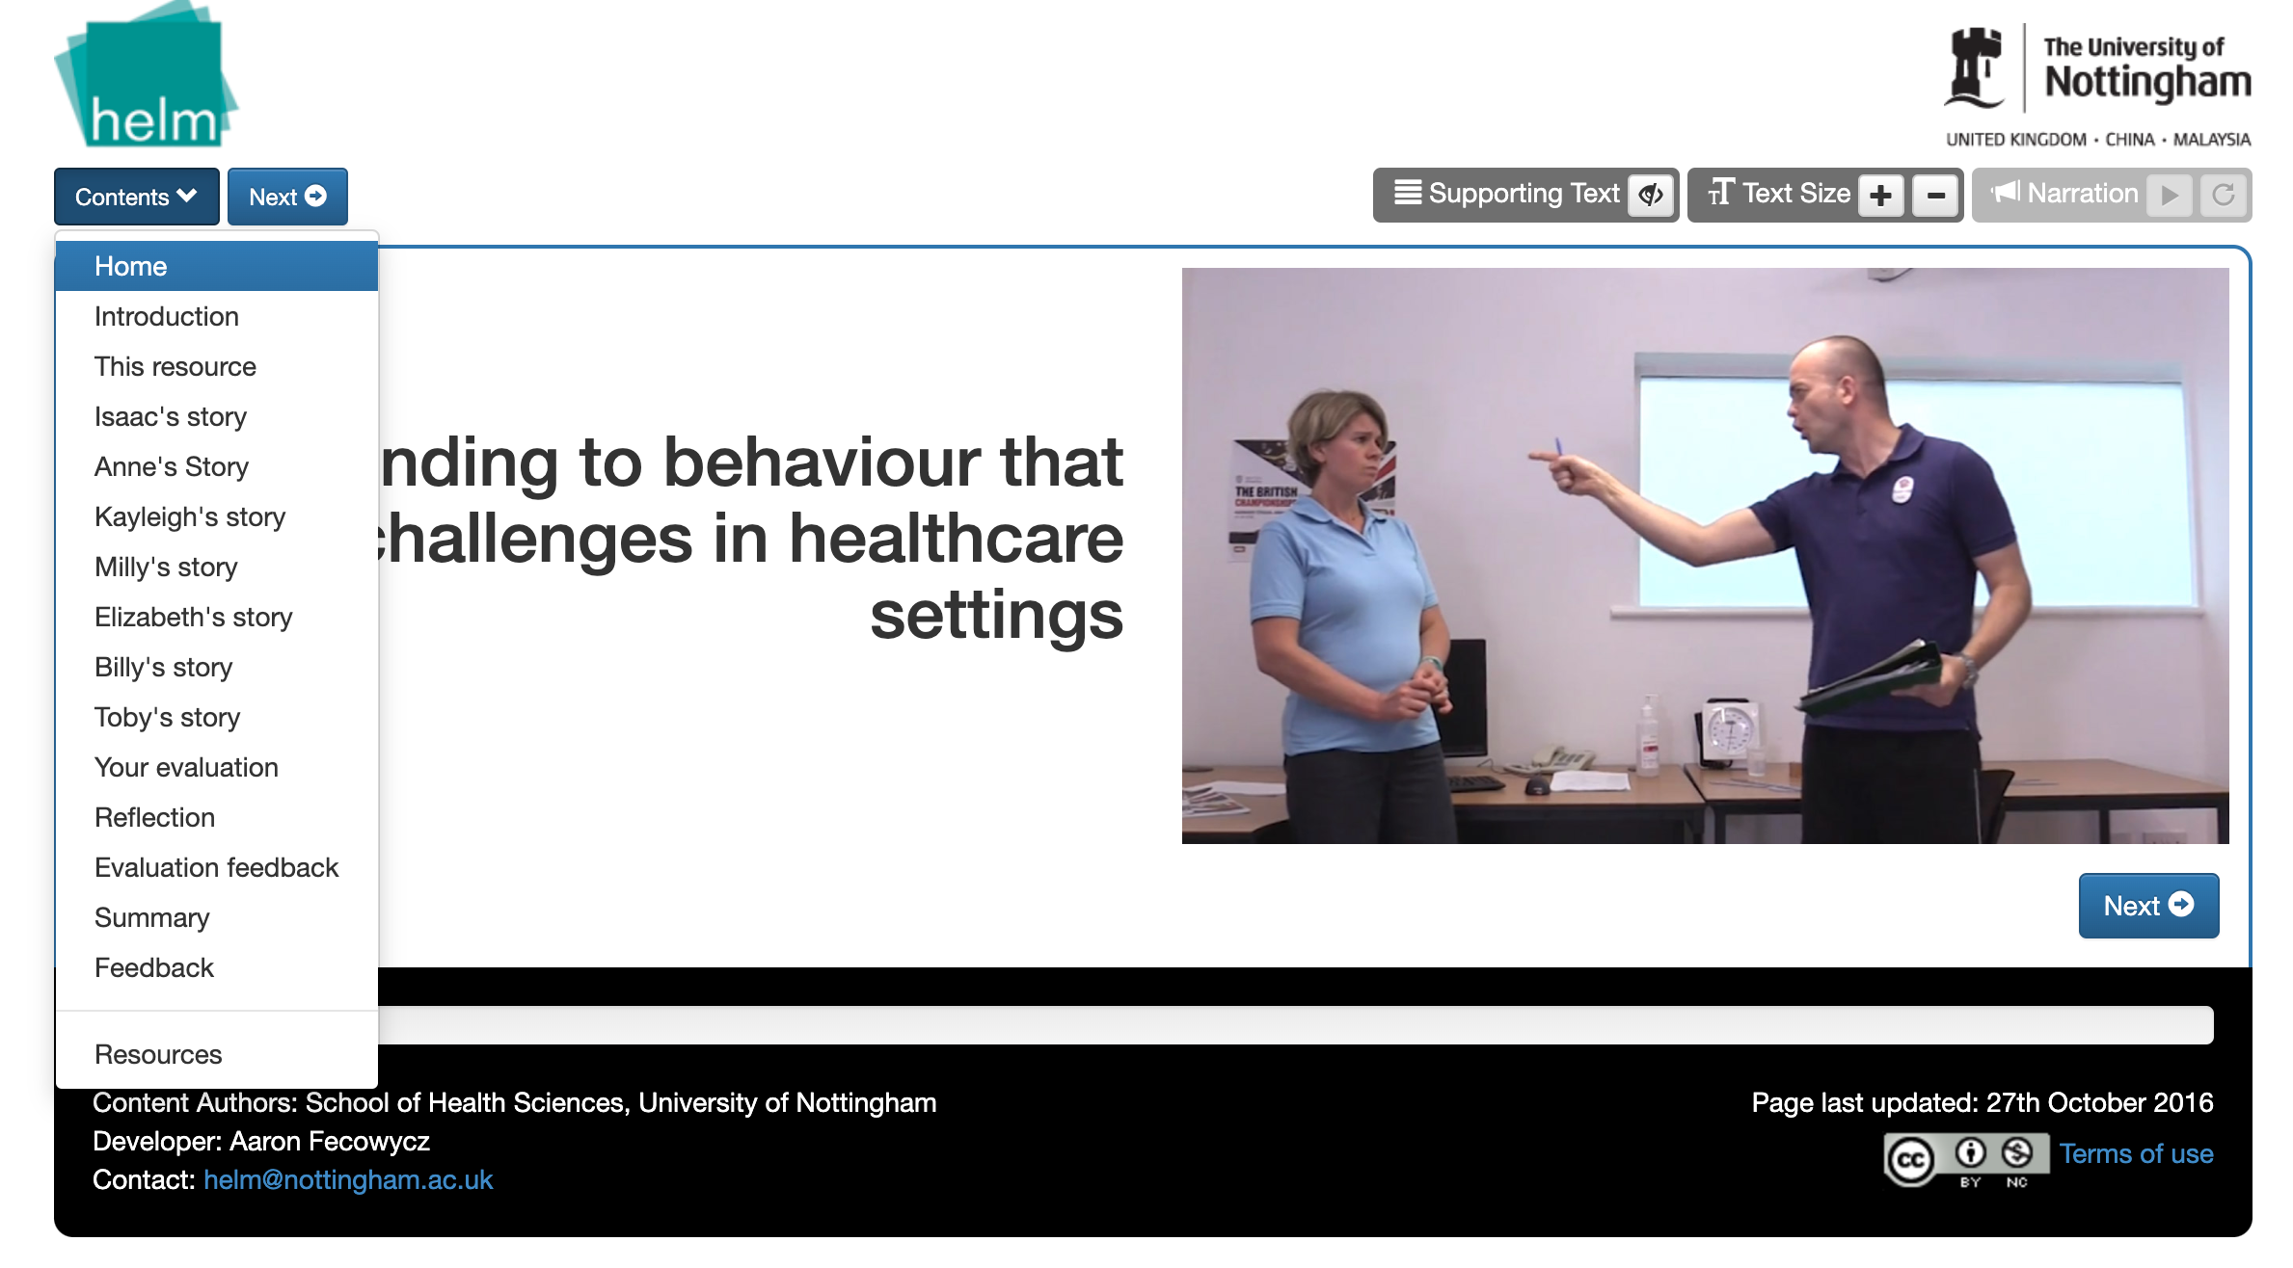
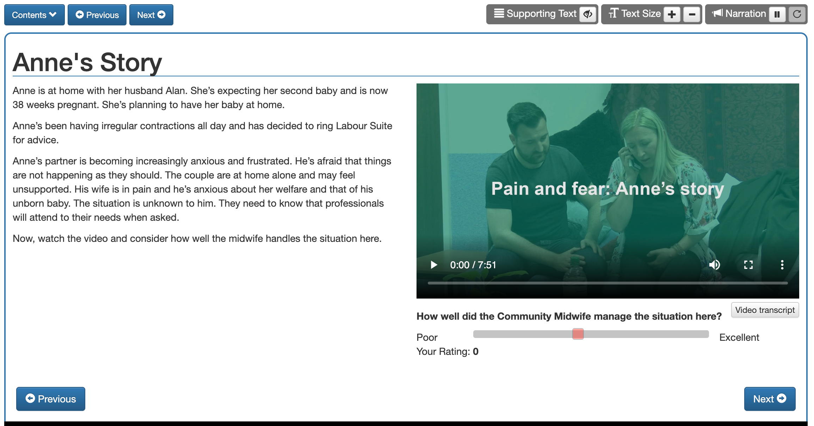
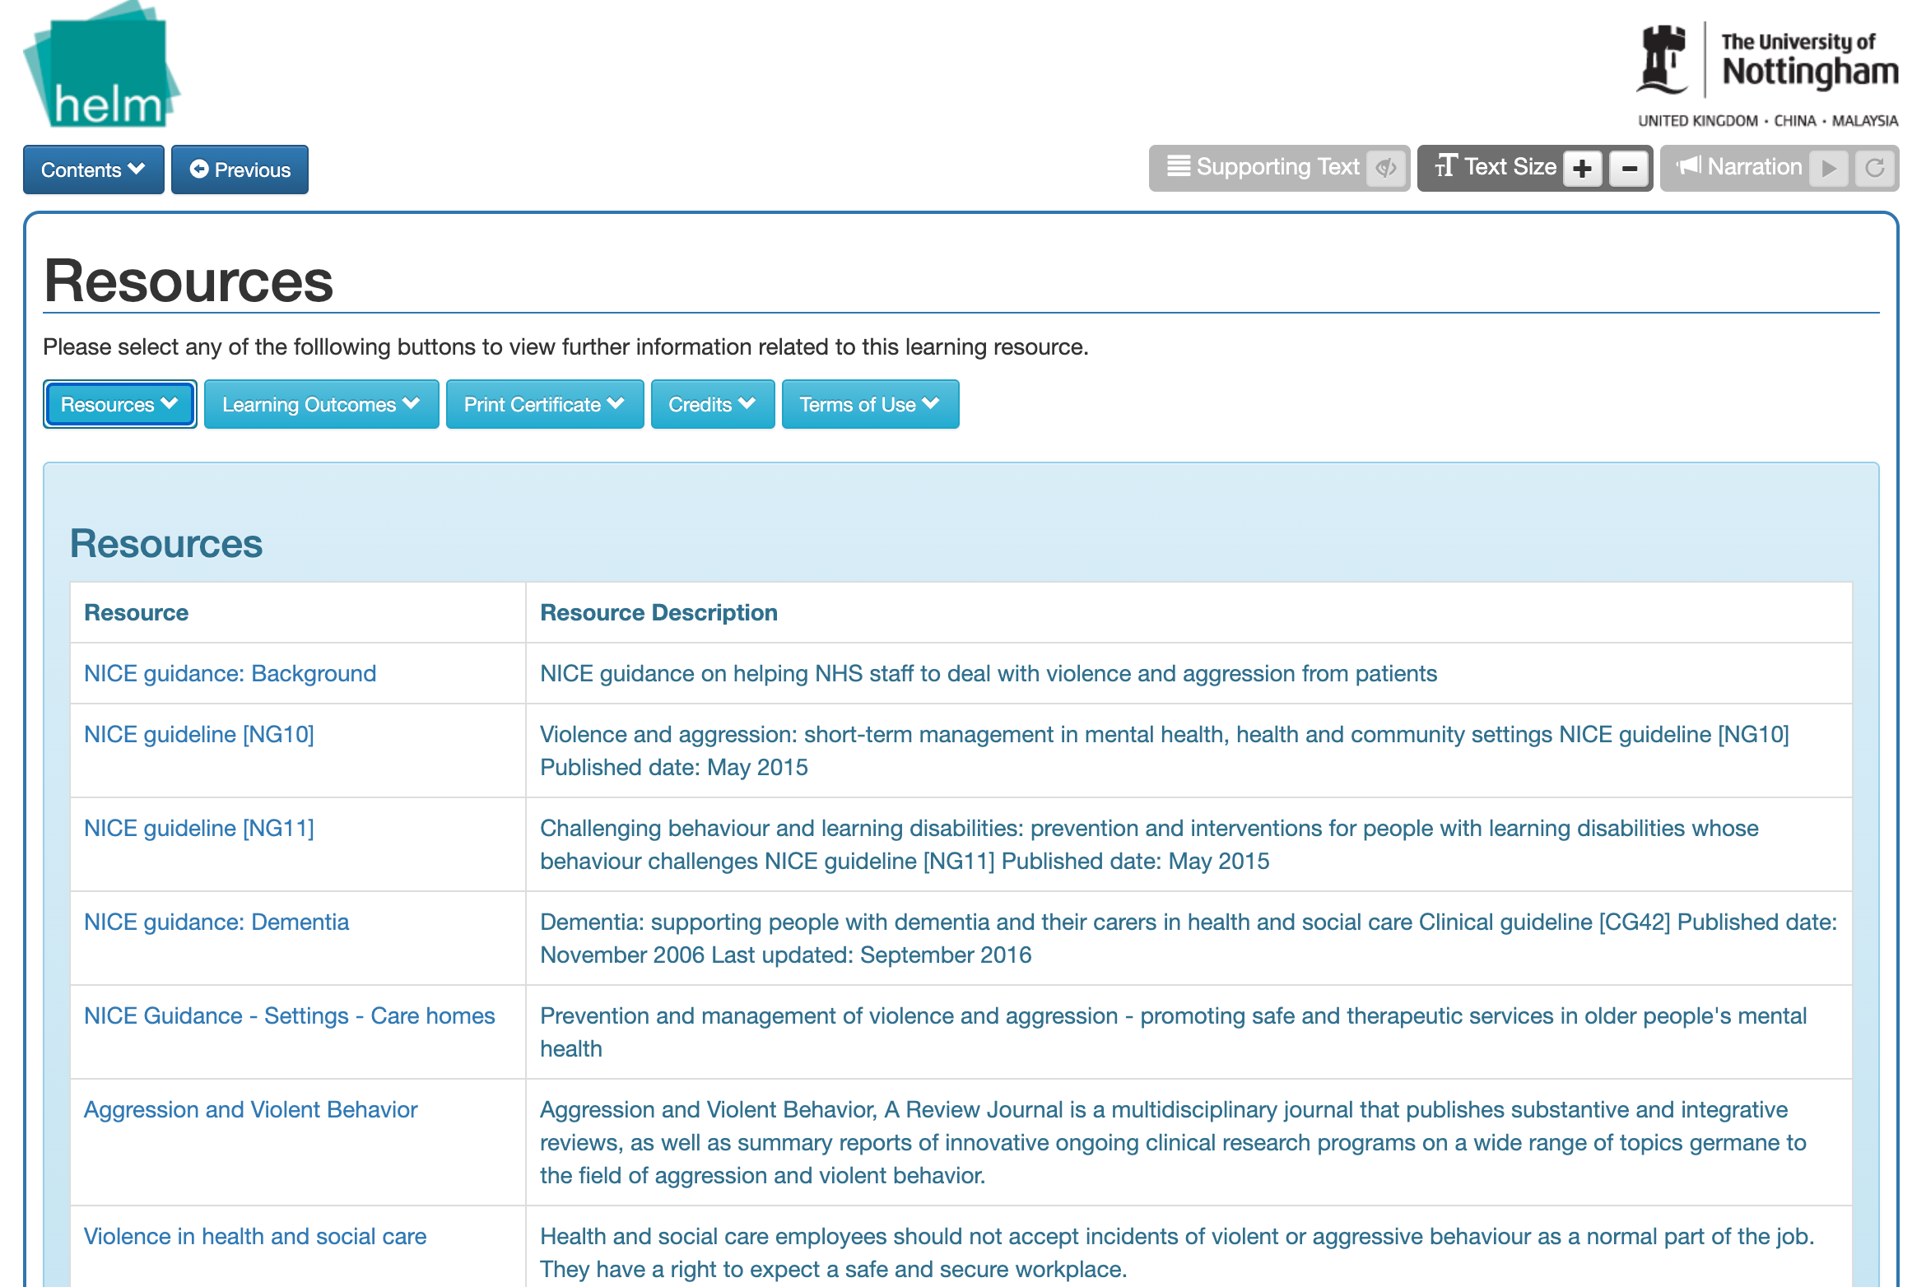
What might the toolkit look like? (1)
Support from University Health E-Learning and Media Team
Reusable learning objects stored in online repository, accessible via link
Notes:
Booklets targeted at the person with the health condition
Workbooks & slide sets targeted at upskilling and influencing employer change

Slide 12
What might the toolkit look like? (2)
Multi-stakeholder co-design process
Employer
  Focus of toolkit (e.g., Behaviour change? Educational?)
  E.g., Planning and managing RTW and job retention, improve knowledge of stroke
Materials for stroke survivors?
  E.g., Self-management, how to communicate needs/issues, legal advice
Training resources, e.g., evidence-based guides/videos/worksheets
Signposting to relevant agencies?

Slide 13
Any questions?

Slide 14
References (1)
1. England PH. Briefing document: First incidence of stroke, estimates for England 2007 to 2016. London; 2018.
2. Stroke Association. The value of our services. London: Stroke Association; 2018.
3. Equality Act 2010, c15.
4. (NICE) NIfHaCE. Workplace health: long-term sickness absence and capability to work (NICE guideline NG146). London: NICE.
5. Hellman T, Bergström A, Eriksson G, Falkdal AH, Johansson U. Return to work after stroke: Important aspects shared and contrasted by five stakeholder groups. Work. 2016;55(4):901-11.
6. Ost Nilsson A, Eriksson G, Asaba E, Johansson U, Hellman T. Being a co-worker or a manager of a colleague returning to work after stroke: A challenge facilitated by cooperation and flexibility. Scandinavian journal of occupational therapy. 2020;27(3):213-22.
7. Coole C, Radford K, Grant M, Terry J. Returning to Work After Stroke: Perspectives of Employer Stakeholders, a Qualitative Study. Journal of occupational rehabilitation. 2013;23(3):406-18.
8. Donker-Cools BHPM, Schouten MJE, Wind H, Frings-Dresen MHW. Return to work following acquired brain injury: the views of patients and employers. Disability and rehabilitation. 2018;40(2):185-91.
9. Thoele K, Ferren M, Moffat L, Keen A, Newhouse R. Development and use of a toolkit to facilitate implementation of an evidence-based intervention: a descriptive case study. Implementation Science Communications. 2020;1(1):86.
10. Berkeley UoC. How to build an implementation toolkit from start to finish 2022 [Available from: https://calswec.berkeley.edu/toolkits/implementation-toolkits/how-build-implementation-toolkit-start-finish.

Slide 15
References (2)
11. Greidanus MA, de Boer AGEM, Tiedtke CM, Frings-sen MHW, de Rijk AE, Tamminga SJ. Supporting employers to enhance the return to work of cancer survivors: development of a web-based intervention (MiLES intervention). Journal of cancer survivorship. 2020;14(2):200-10.
12. Schumacher L, Armaou M, Rolf P, Sadhra S, Sutton AJ, Zarkar A, et al. Usefulness and engagement with a guided workbook intervention (WorkPlan) to support work related goals among cancer survivors. BMC psychology. 2017;5(1):34.
13. Volker D, Zijlstra-Vlasveld MC, Anema JR, Beekman ATF, Brouwers EPM, Emons WHM, et al. Effectiveness of a blended web-based intervention on return to work for sick-listed employees with common mental disorders: Results of a cluster randomized controlled trial. Journal of medical Internet research. 2015;17(5):e116-e.
14. Lokman S, Volker D, Zijlstra-Vlasveld MC, Brouwers EP, Boon B, Beekman AT, et al. Return-to-work intervention versus usual care for sick-listed employees: health-economic investment appraisal alongside a cluster randomised trial. BMJ open. 2017;7(10):e016348.
15. Bouffard J, Durand M-J, Coutu M-F. Adaptation of a Guide to Equip Employers to Manage the Gradual Return to Work of Individuals with a Musculoskeletal Disorder. Journal of occupational rehabilitation. 2019;29(3):625-35.
16. Greidanus MA, de Rijk AE, Frings-Dresen MHW, Tiedtke CM, Brouwers S, de Boer AGEM, et al. The Use and Perceived Usefulness of an Online Toolbox Targeted at Employers (MiLES Intervention) for Enhancing Successful Return to Work of Cancer Survivors. Journal of occupational rehabilitation. 2020.
17. (NICE) NIfHaCE. NICEimpact stroke. London: NICE; 2015.

