Slide 1


Co-design of a return-to-work toolkit for employers and stroke survivors
October 2023: Workshop 2
Kristelle Craven
Kristelle.craven1@nottingham.ac.uk
Notes:
“Thank you to everyone for attending today. At the end of this session, we will have come up with some ideas for the toolkit’s content, design, and implementation. You have all been invited because you have the knowledge and experienced needed to inform the session. We are recording this workshop, so please avoid stating names if you mention anything confidential relating to another person or organisation. If you need a break at any point, please go ahead – stand up, move around, make a drink. It’s quite informal.”

Slide 2
Session agenda
Introduction/ icebreaker
(20 mins)
Workshop 1: Recap
(10 mins)
Task 1: Brainstorming ideas for toolkit content (45 mins)
Task 2: Brainstorming ideas on toolkit design and implementation (45 mins)

Slide 3
Introductions and icebreaker activity (20 mins)
Who you are
Icebreaker question:
Best piece of advice you’ve ever been given, and why?

Slide 4
Workshop 1: Selection of priority areas for toolkit
It was decided the toolkit should focus on:
Stroke survivors
Employers
1. Disclosing needs to employers
2. Increasing and maintaining understanding of stroke survivors’ abilities
3. Providing reasonable adjustments when needed

Slide 5

Overarching goal of toolkit
Empower employers and stroke survivors to plan and manage a timely and sustainable return-to-work post-stroke

Slide 6
Potential issues identified
Employers
Negative beliefs about stroke and possibility of return to work
Lack knowledge of stroke and own responsibilities
Over-estimate stroke survivor’s abilities
Don’t know who can help- or unwilling to talk about stroke survivor’s abilities
Anxious about potential impact of stroke survivor’s return on colleagues
Concerned about cost of reasonable adjustments
Not confident/skilled in carrying out reasonable adjustments or supportive actions
Stroke survivors
Believe work caused their stroke
Worry about future impact of work on health
Don’t know if ready to return to work
Unaware/don’t know who can help them understand abilities
Fear highlighting limitations to employers

Slide 7
Task 1: What content would be helpful?
Step 2
Step 3
Stroke survivor* identifies what is needed for them to return to work role.
Employer recognises need for support with providing reasonable adjustments for stroke survivor. Considers how stroke survivor’s return may impact wider team.
Stroke survivor* decides which needs should be communicated to the employer.
Employer identifies appropriate stakeholders and sources of support with needs identified in Steps 1 and 2.
Step 1
Stroke survivor* decides they are ready to start planning to return to work, and communicates this to employer. Appraises strengths and limitations relating to work role.
Employer contacts stroke survivor and jointly agrees communication schedule. Recognises knowledge limitations (e.g., stroke and its impact, own responsibilities, internal/external resources available for stroke survivor).
*Liaising with relevant stakeholders where possible
Toolkit goal
Empower employers and stroke survivors to plan and manage a timely and sustainable return-to-work post-stroke.
Step 4
Stroke survivor* clearly communicates needs to employer
Employer liaises with relevant stakeholders or organisations, reviews information, or attends training.
Step 5
Stroke survivors repeat steps 2-4* Stroke survivors and employers meet regularly to review stroke survivors’ needs. Employer repeats step 4.
START HERE

Slide 8
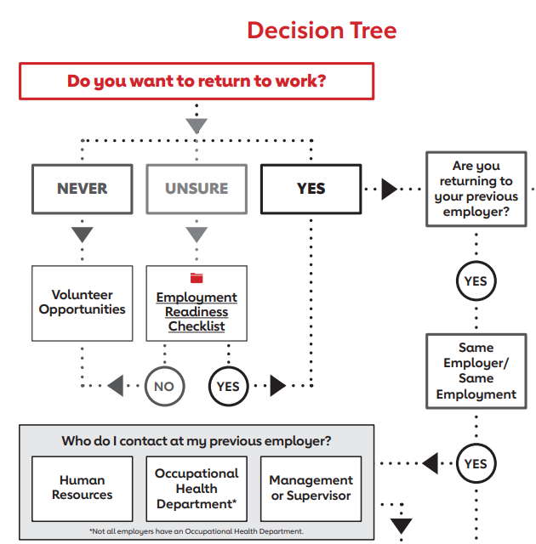
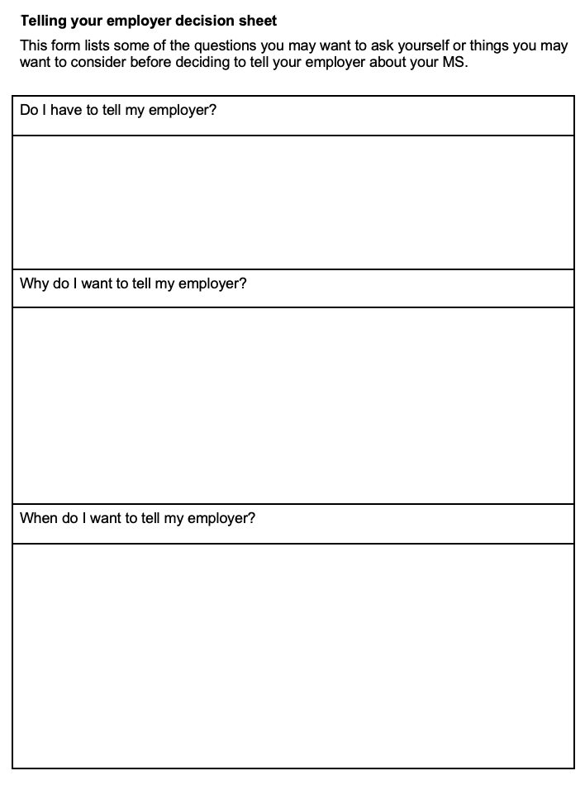
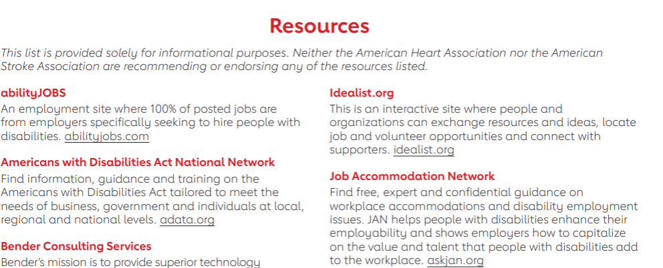
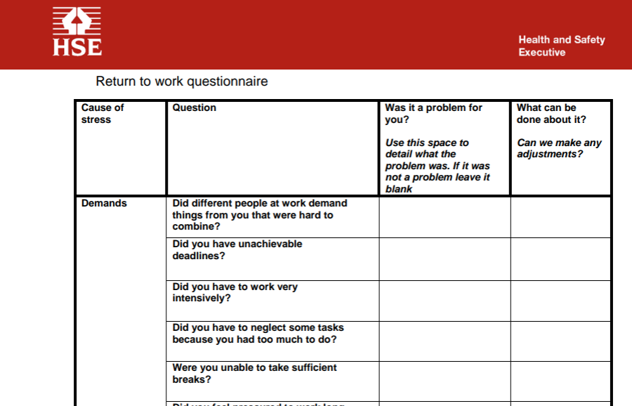
Examples of content from other toolkits (1)

Slide 9
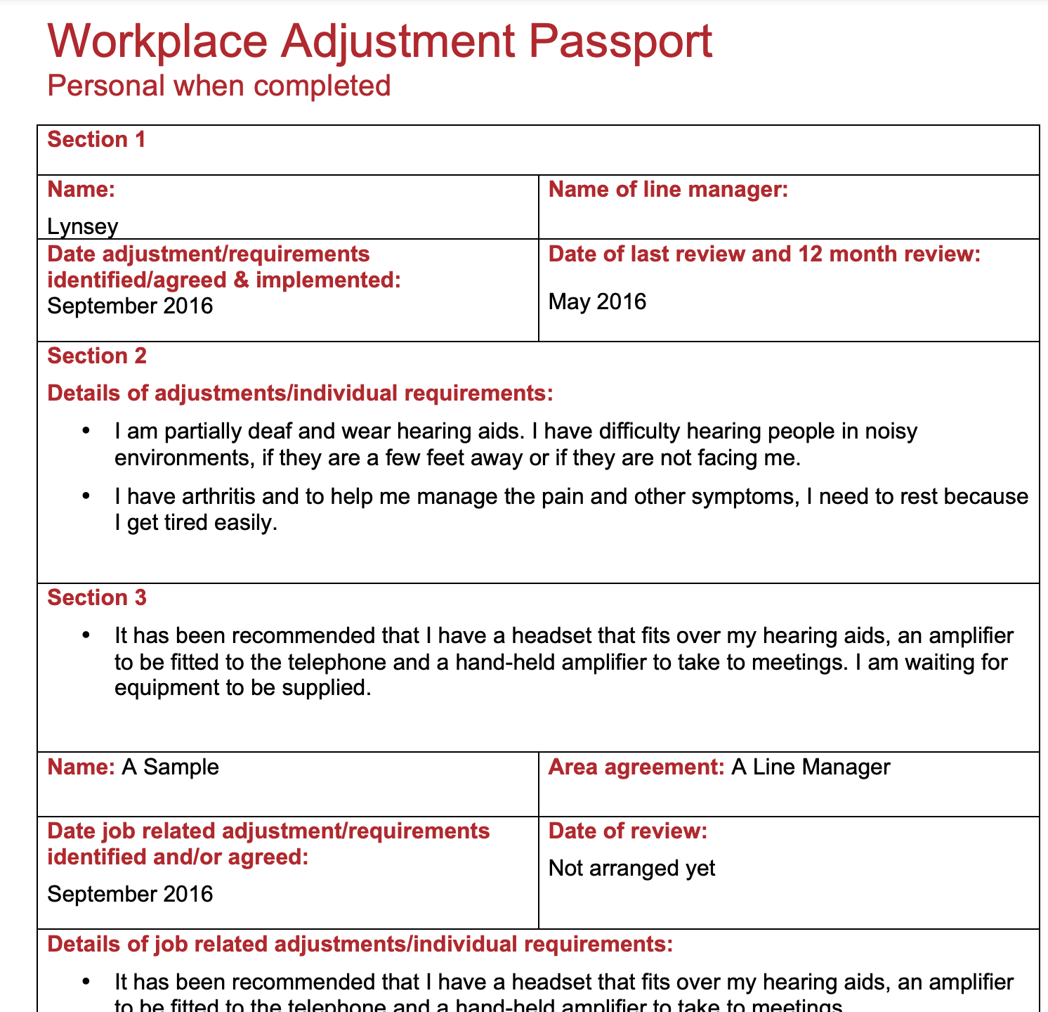
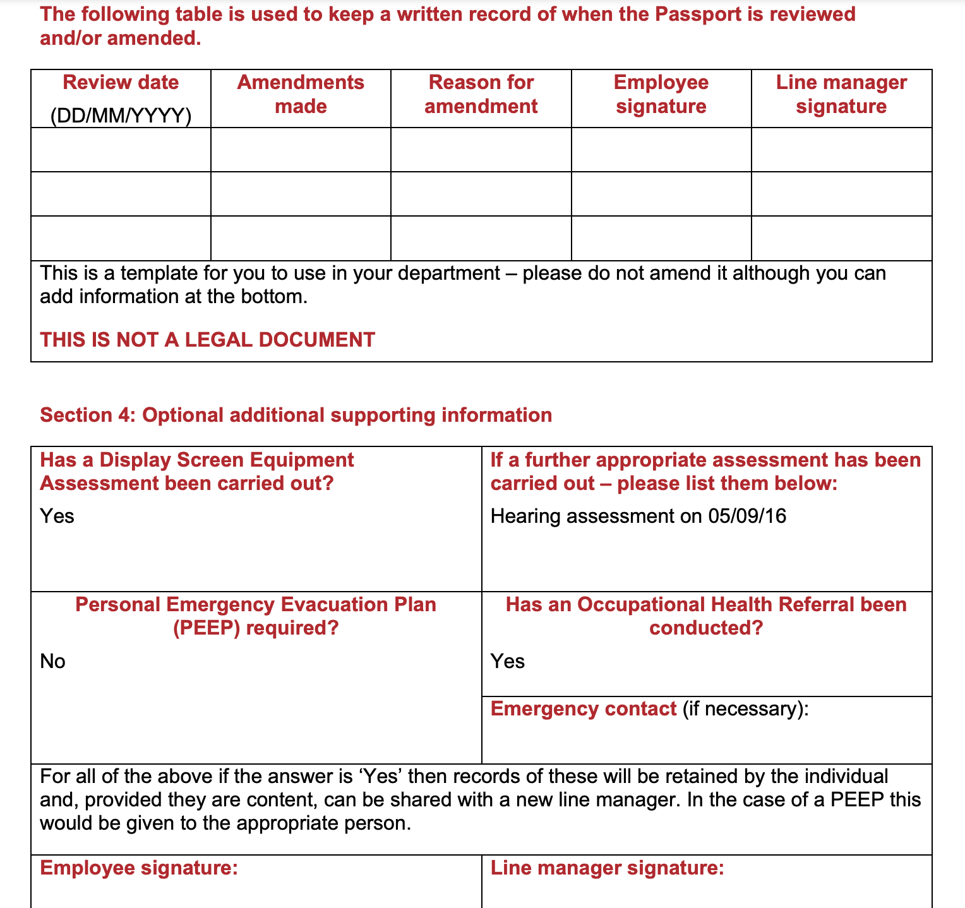
Examples of content from other toolkits (2)

Slide 10

Suggestions for mode and content of toolkit so far…
Videos of stroke survivors…
Discussing positive impact of disclosure
Scenarios demonstrating positive disclosure between stakeholders
Explaining challenges returning to work with residual limitations
Examples of conversation starters (e.g., to assess stroke survivor’s readiness, encourage disclosure)
Information/advice about…
Impact stroke can have (e.g., fatigue) on working-age stroke survivors
Stroke impacts people differently
Range of different causes of stroke
How to introduce stroke survivor back into team following absence
Stroke survivors be informed of their rights if they disclose needs
Stroke survivors might not realise limitations and needs until return to work attempted
Managers to review risk assessments
”Buddy” colleague to help stroke survivor re-integrate into workplace
Diary template for stroke survivors to document symptoms and triggers
Checklist/template to record stroke survivors’ work skills and abilities, return-to-work plan, RA passport
Signposting to websites containing useful information/advice, e.g., educational information, helplines, health services

Slide 11

Task 2a: Ideas for toolkit design and testing
What form should it take?
(e.g., website, PDF, e-learning module, combination)
Who might fund its development/testing?
Where should it be stored?
How accessed, by whom, and for how long?
What data would organisations want? (i.e., to encourage future adoption and ongoing use of the toolkit) – interested in impact of ”the gap”, or what will change as a result of using the toolkit?
Notes:
Do you envisage employers paying for this tool or for it to be a free resource? Or are there existing software packages that companies subscribe to with modules on improving accessibility that this could be incorporated into?

Slide 12

Task 2b: What implementation strategies could work in your organisation? Who could carry them out?
1. Staff meetings/briefings, i.e., to promote and raise awareness of toolkit
5. Change policy (e.g., CIPD, within organisations) to encourage decisions to use toolkit
2. Mandate change, e.g.,
Leaders declare priority of using toolkit, and commitment to seeing it used
Toolkit as mandatory training package for line managers
*What data would we need for this to be actioned? Who should we present the data to?
6. Accreditation, i.e., People who affiliate with membership organisation required/recommended to use the toolkit. *Are there any alternative strategies that could incentivise employers to look at the toolkit?
7. Role play exercises within toolkit to simulate using toolkit and carrying out actions
3. Create and distribute educational materials to improve knowledge about the toolkit
8. Coalition/network, i.e., individuals or organisations to support toolkit use, and help with problem-solving
4. Educational, interactive sessions to improve knowledge about the toolkit
How do we sell these as potential implementation strategies to organisations?
Notes:
Examples of data-driven marketing – Changes in knowledge scores, etc? User satisfaction, user loyalty/traffic quality (e.g., average page views per session), profitability (e.g., cost per buy – profit/total cost of an investment), strengthen brand (e.g., impressions), Total sickness absence of stroke survivors in a year…

Slide 13
Thank you
If you have anything additional you would like to tell us or ask about, please email: Kristelle.craven1@nottingham.ac.uk
@CravenKristelle

