Slide 1
TEM images of NPs
Analysing NP distribution and the morphology

Slide 2
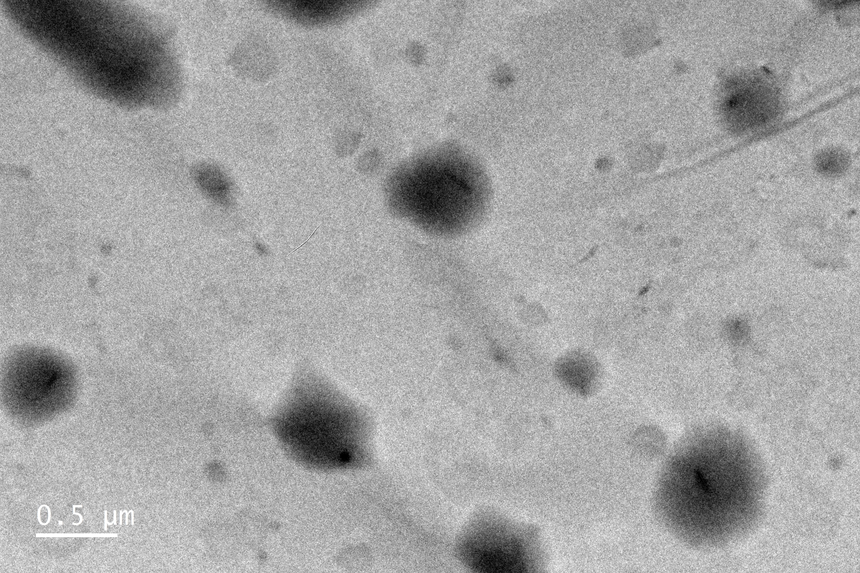
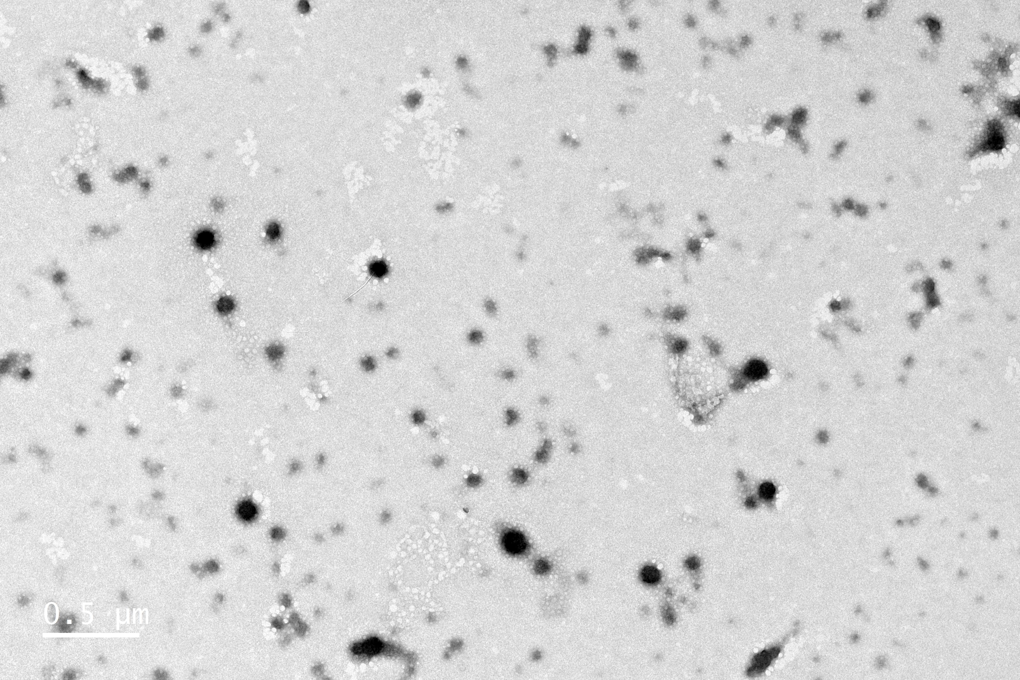
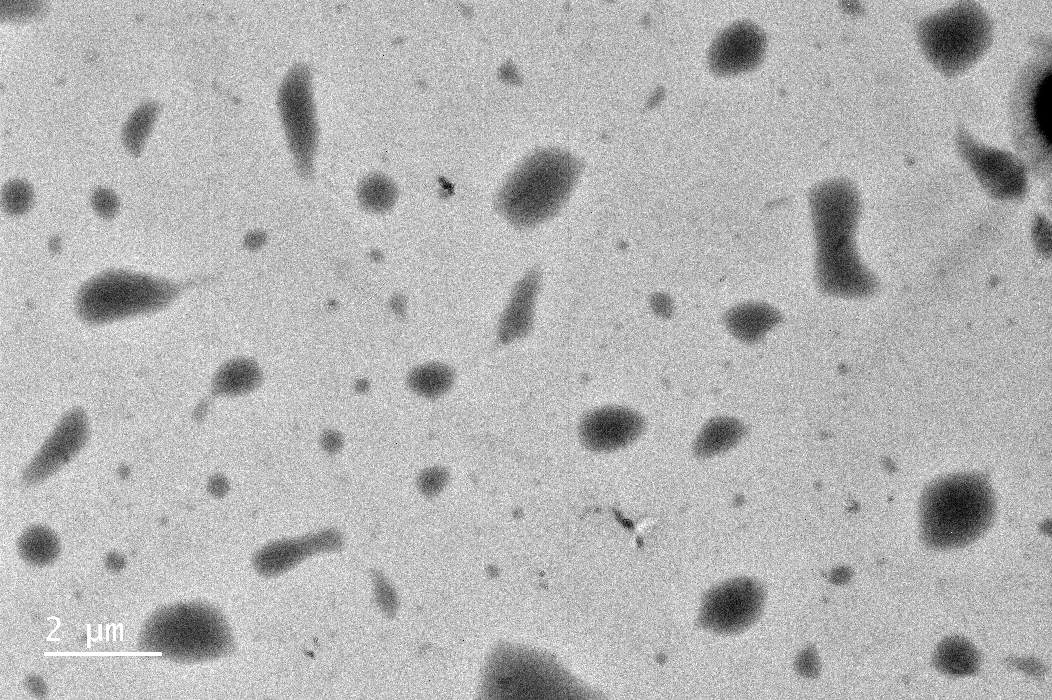
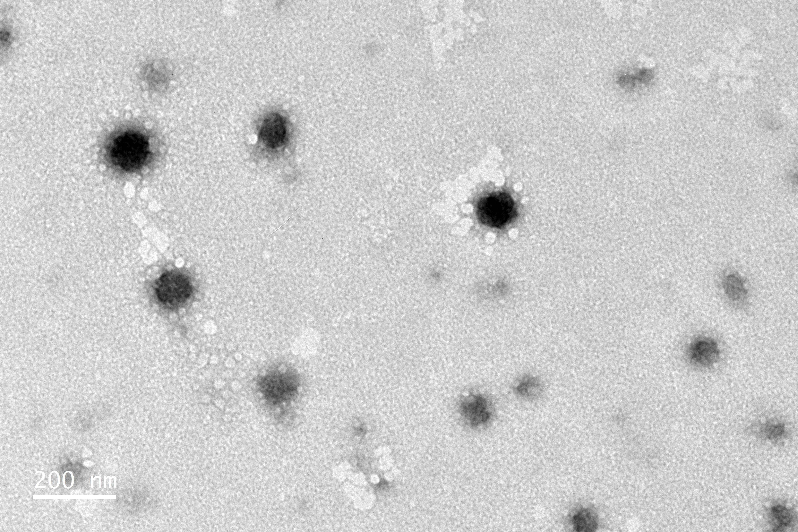
3LT2 (-)
3LT2 (+)
Scale bars 0.5 µm
Scale bars 2 µm for (-) and 200 nm for (+)

Slide 3
(a)
TETA-3L2
(b)
TETA-3L2-CB8

