Slide 1
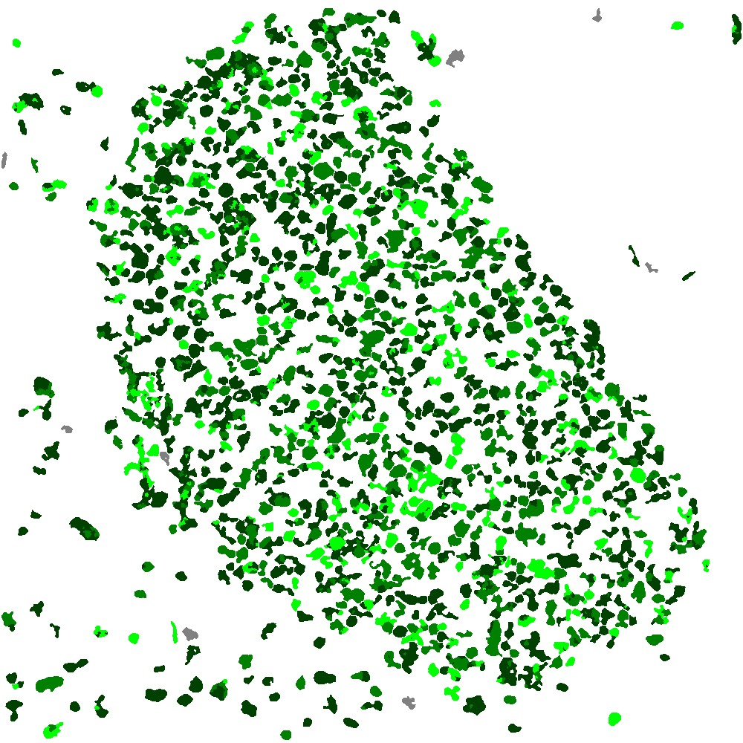
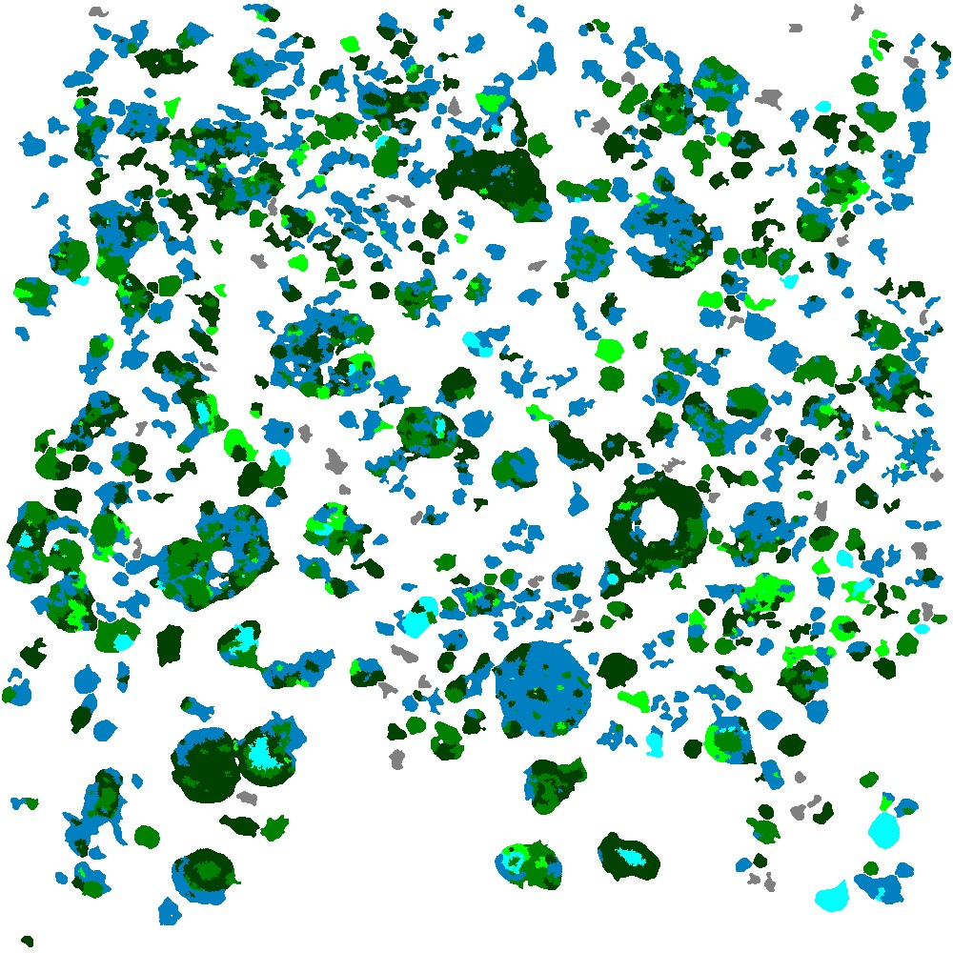
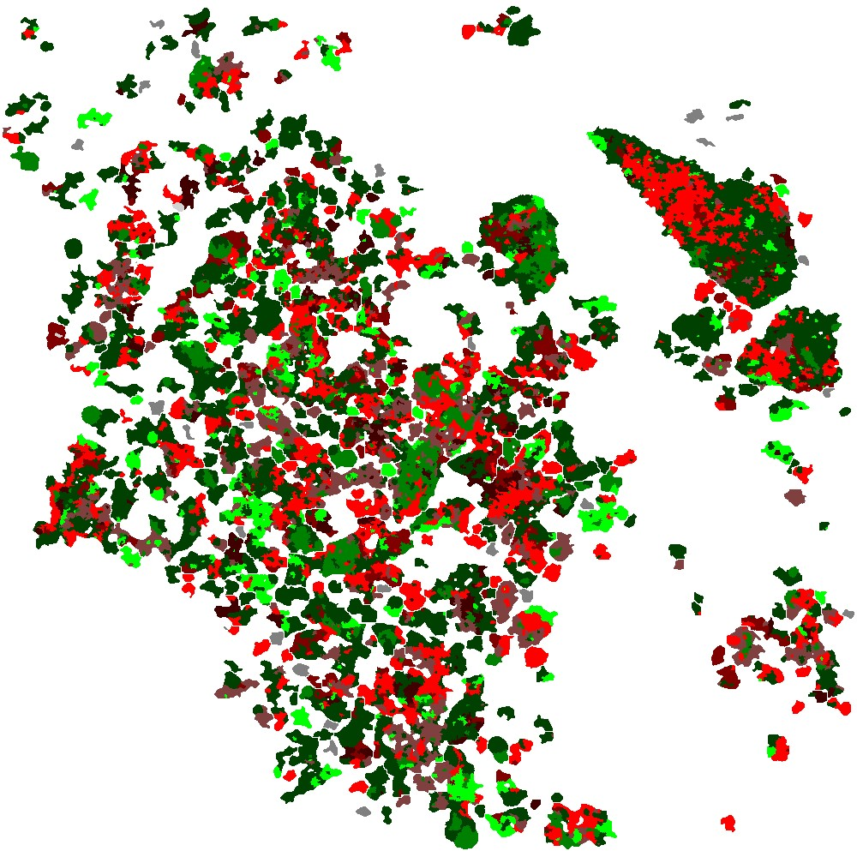
100 μm
100 μm
100 μm
•Zn60 •Zn58 •Zn56 •Mg3 Zn57 •Mg5 Zn52 •Fe8 Zn50
•Fe12 Zn38 •Fe19 Zn38 •Fe50 Zn20 •Unknown

Slide 2
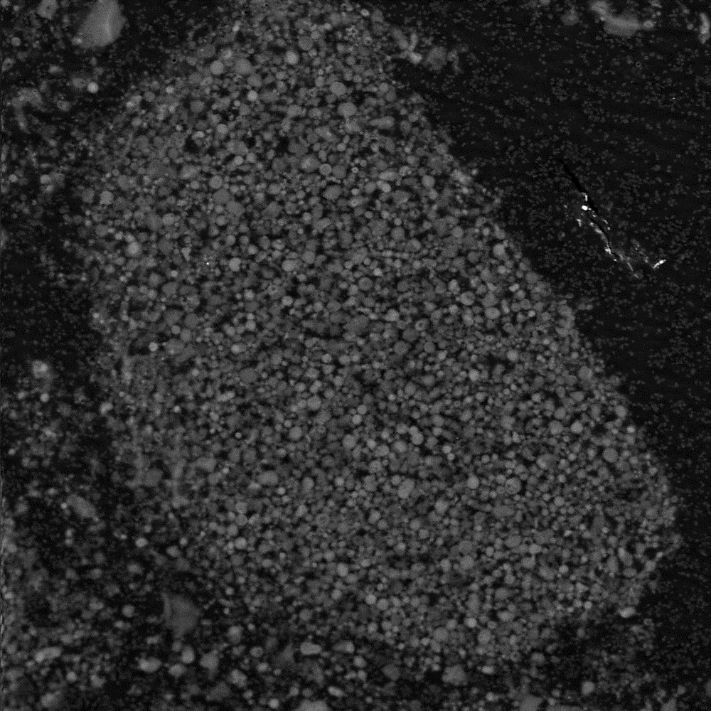
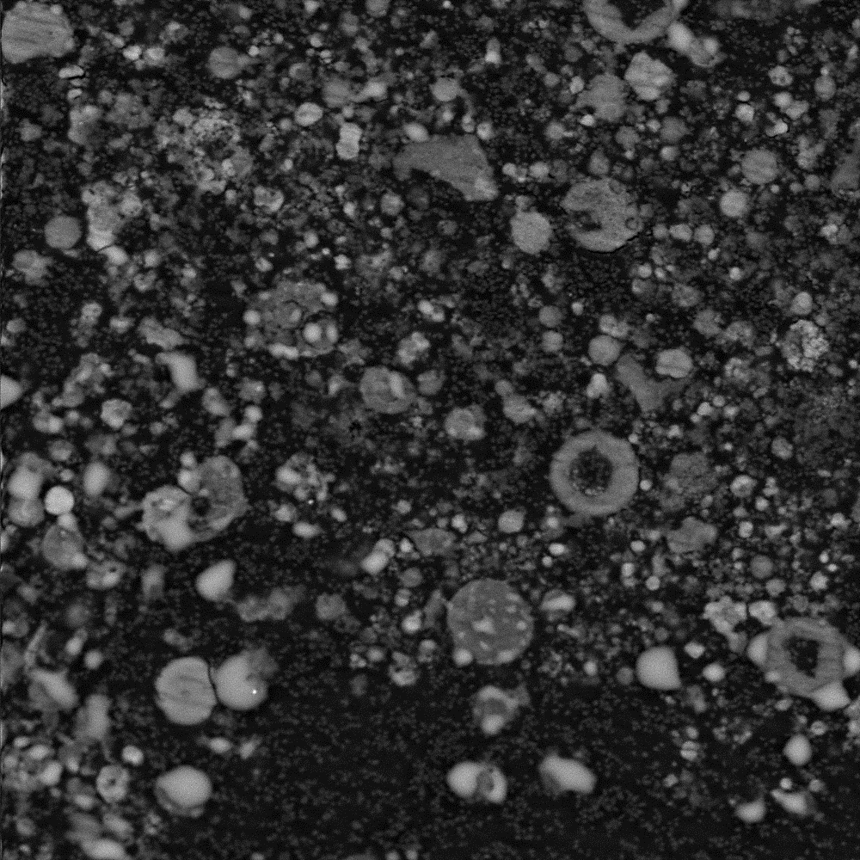
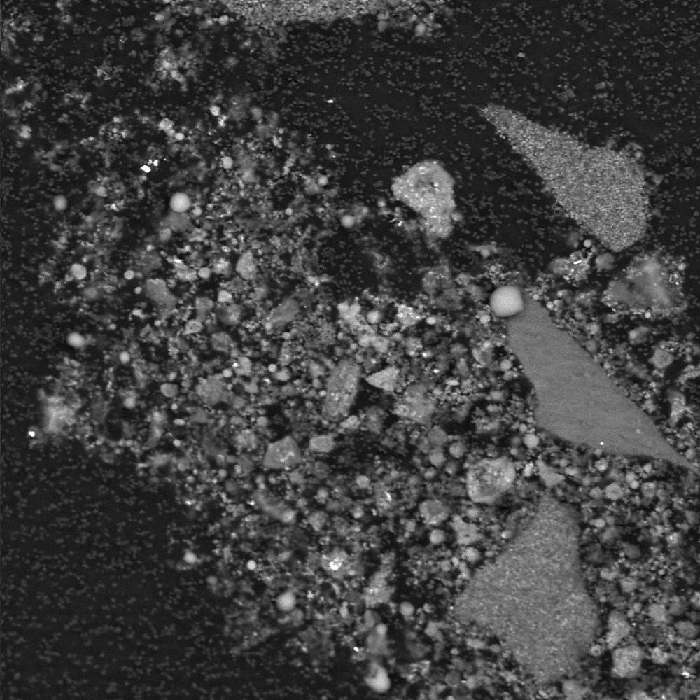
(a)
(b)
(c)
100 μm
100 μm
100 μm

Slide 3
Mineral | FU-40C: Pure MOFs |  | FU-38D: Mg modified |  | FU-40B: Fe₃O₄ modified
 | Particles | Norm. wt% | Particles | Norm. wt% | Particles | Norm. wt%
Zn60 | 1977 | 57.66 | 1037 | 25.78 | 1108 | 45.63
Zn58 | 1245 | 27.41 | 704 | 26.43 | 286 | 6.60
Zn56 | 907 | 14.93 | 415 | 6.10 | 417 | 8.07
Mg3 Zn57 | - | - | 187 | 1.04 | - | -
Mg5 Zn52 | - | - | 1537 | 40.65 | - | -
Fe8 Zn50 | - | - | - | - | 531 | 17.09
Fe12 Zn38 | - | - | - | - | 305 | 9.31
Fe19 Zn38 | - | - | - | - | 300 | 5.97
Fe50 Zn20 | - | - | - | - | 381 | 7.34
Unknown | - | - | 24 | 0.0 | 26 | 0.0

Slide 4
Mineral | Modal minerology
 | Zn | Mg | Fe | K | O
Zn60 | 59.62 | - | - | 21.41 | 18.97
Zn58 | 57.67 | - | - | 23.43 | 18.90
Zn56 | 56.48 | - | - | 24.65 | 18.86
Mg3 Zn57 | 56.77 | 3.11 | - | 20.07 | 20.05
Mg5 Zn52 | 51.97 | 4.74 | - | 22.79 | 20.50
Fe8 Zn50 | 49.65 | - | 7.74 | 23.45 | 19.16
Fe12 Zn38 | 40.62 | - | 12.25 | 27.96 | 19.17
Fe19 Zn38 | 37.68 | - | 18.53 | 24.29 | 19.50
Fe50 Zn20 | 20.20 | - | 50.49 | 8.22 | 21.09

Slide 5
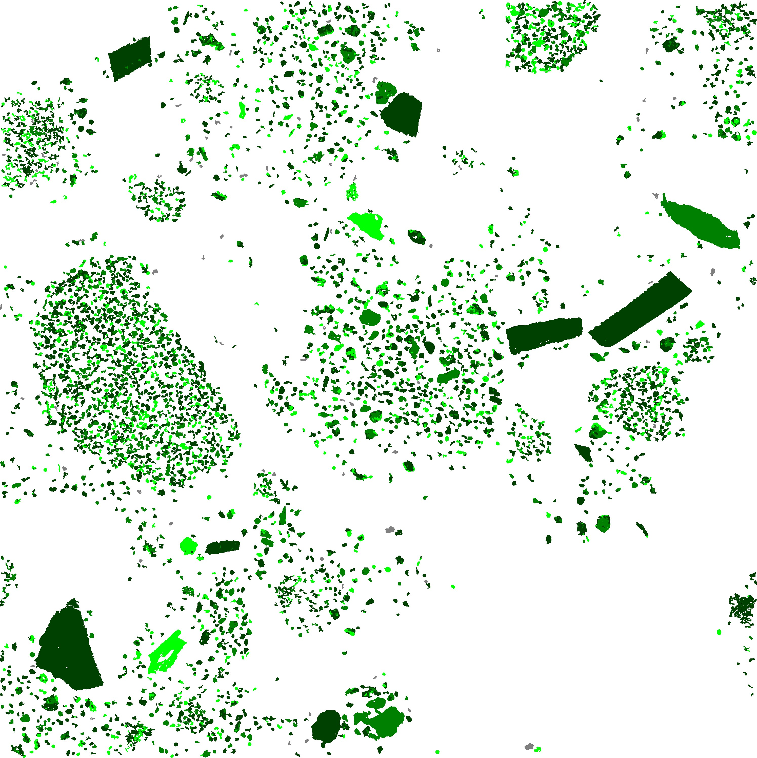
250 μm

Slide 6
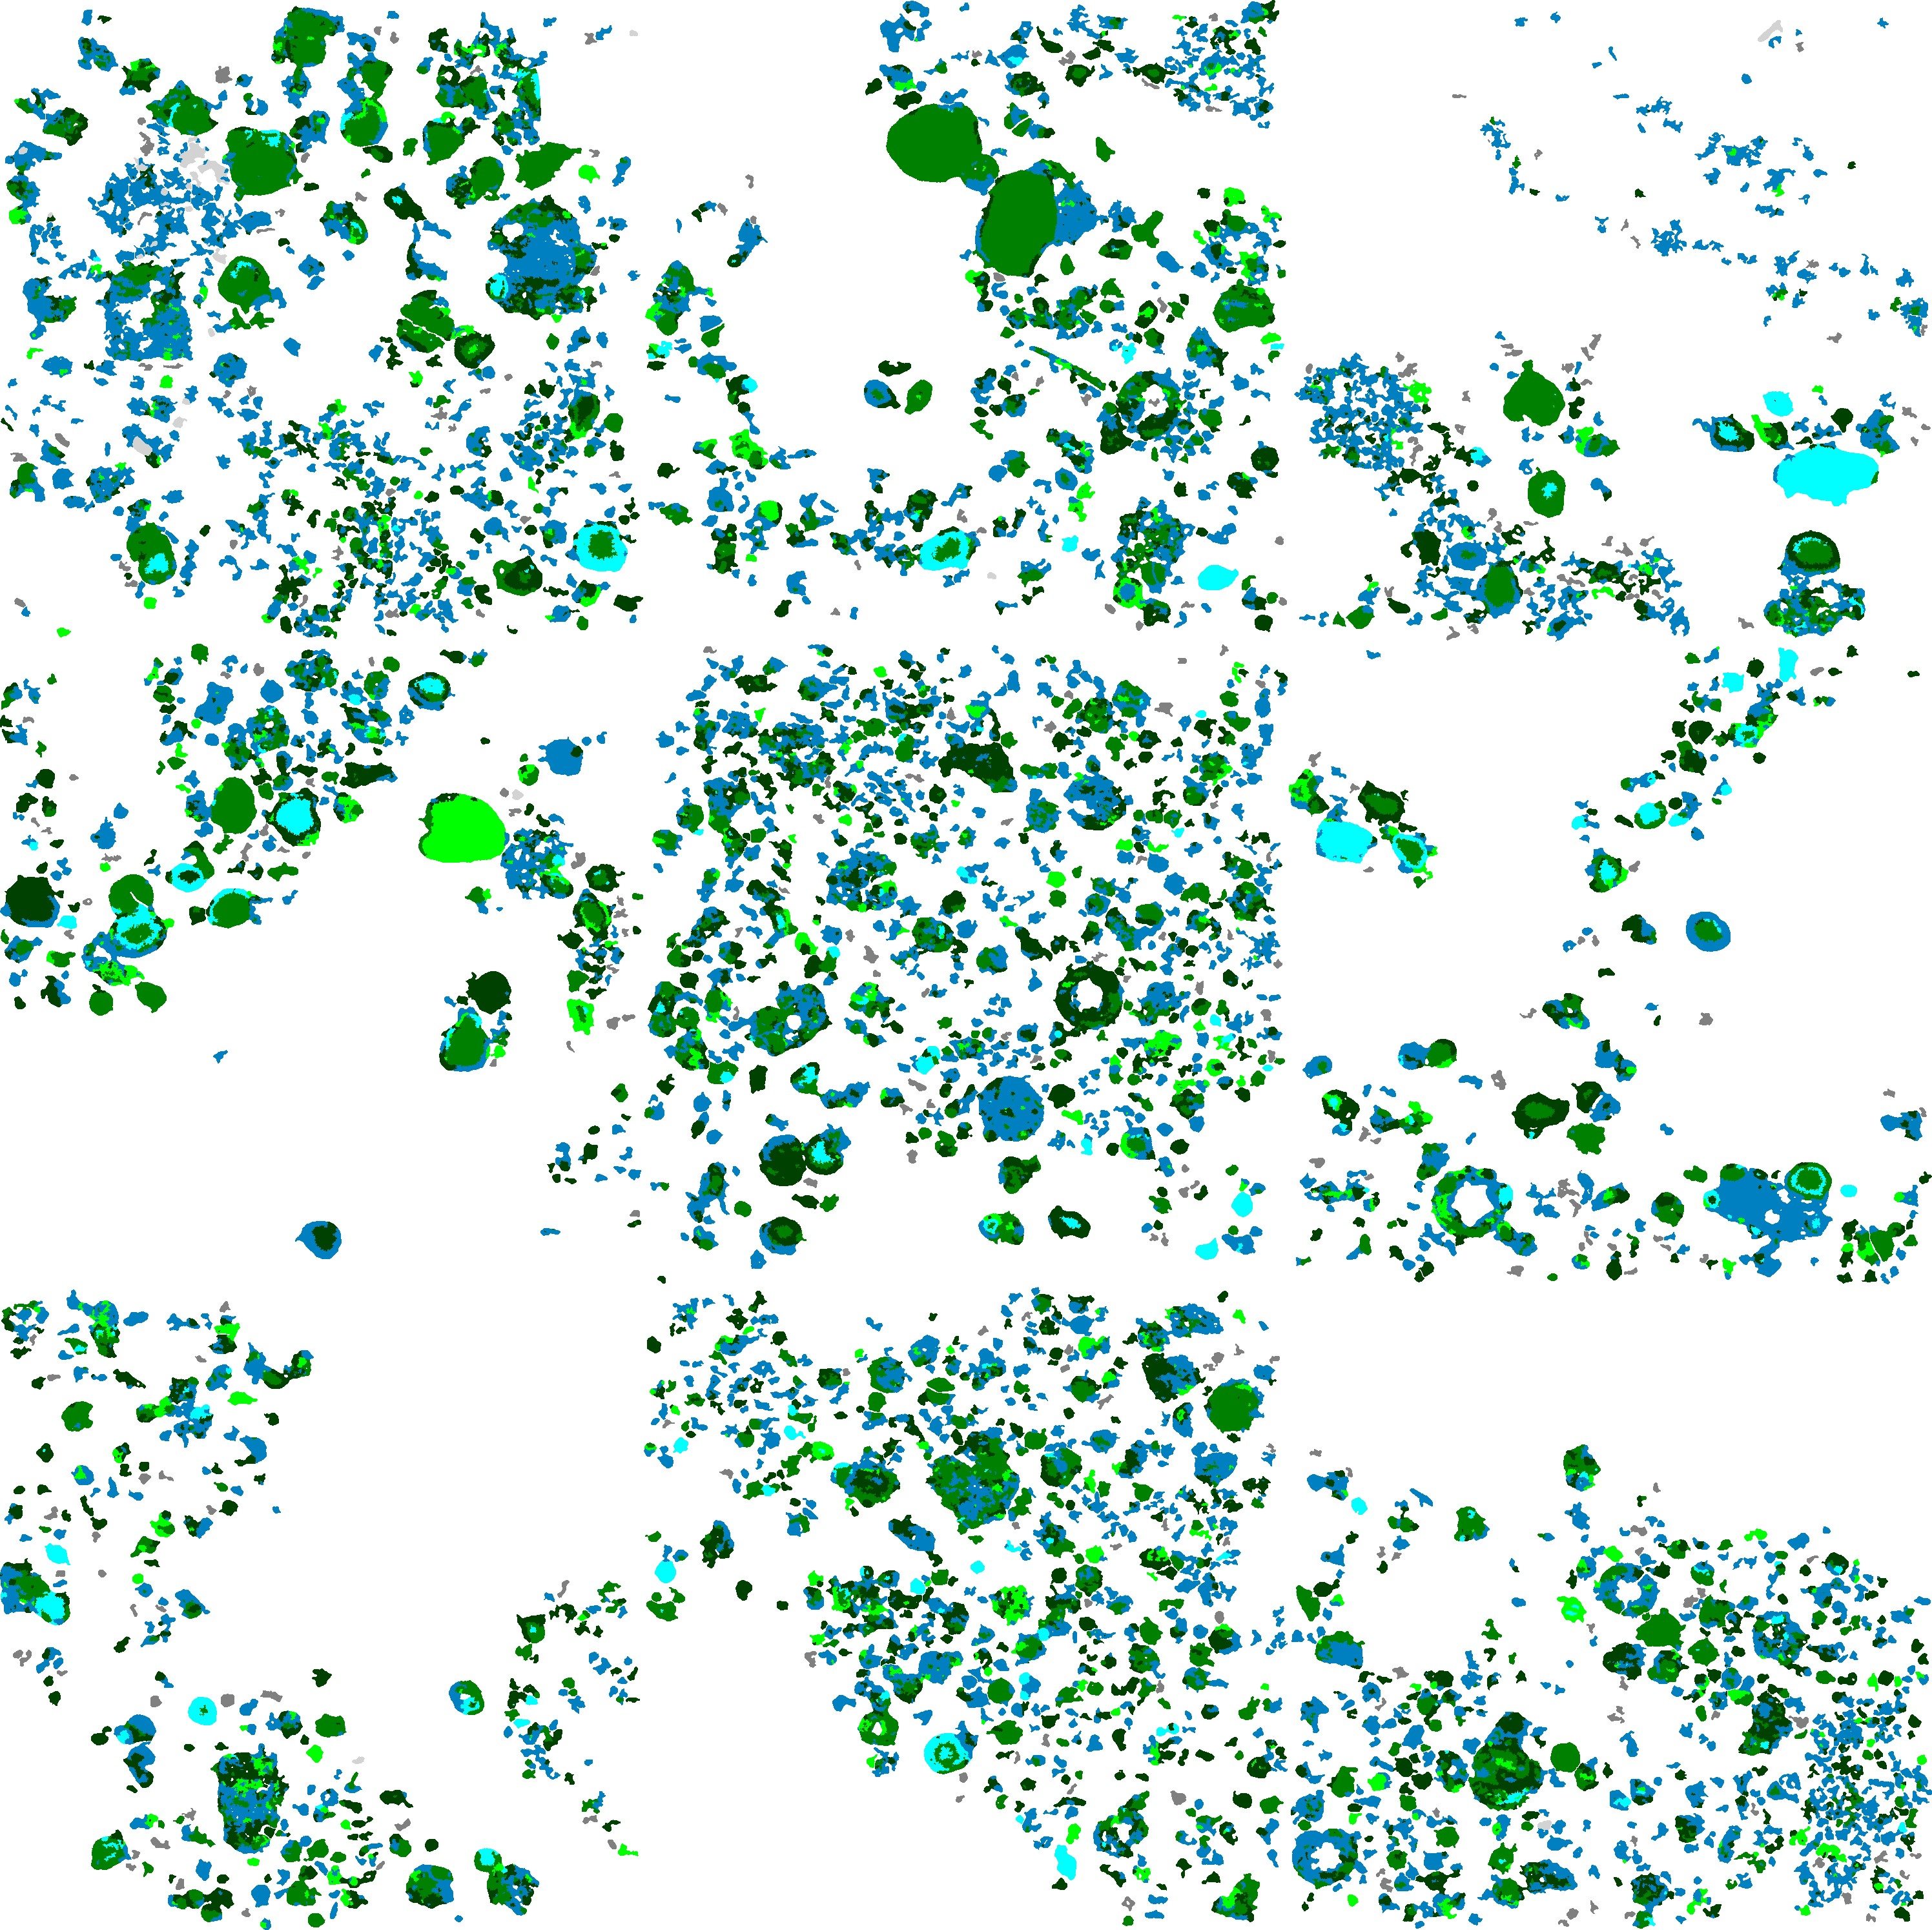
250 μm

Slide 7
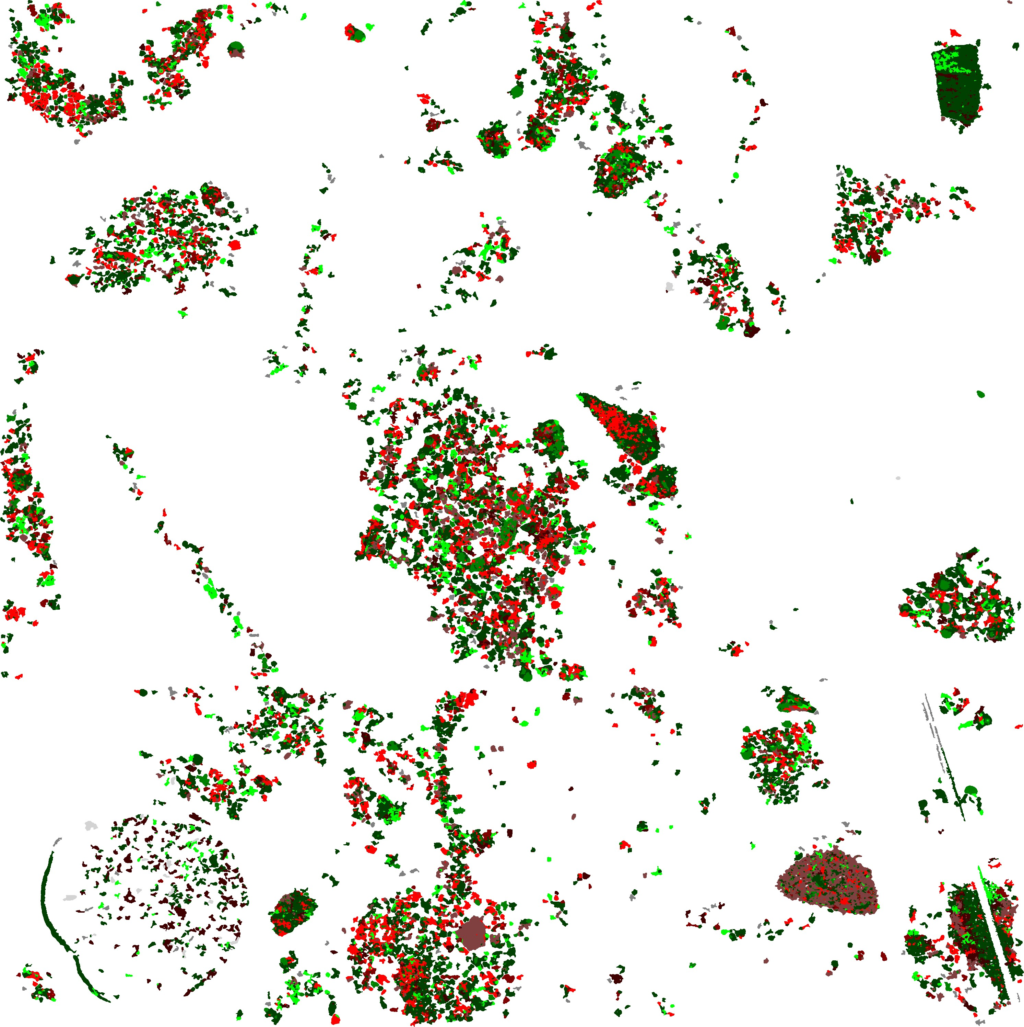
250 μm

