Slide 1



Advisory group meeting: Feedback on TTEAM prototype (employer version)
23rd September 2024
Kristelle Craven
Occupational Therapist & PhD student
@CravenKristelle

Slide 2
Meeting agenda
Introductions
(15 mins)
Group discussion on TTEAM design, technical features, and content (60 mins)
Opportunity to ask questions (10 mins)
Overview of TTEAM
(5 mins)

Slide 3

Introductions
Notes:
(high workloads, inadequate work accommodations, environments and policies)

Slide 4
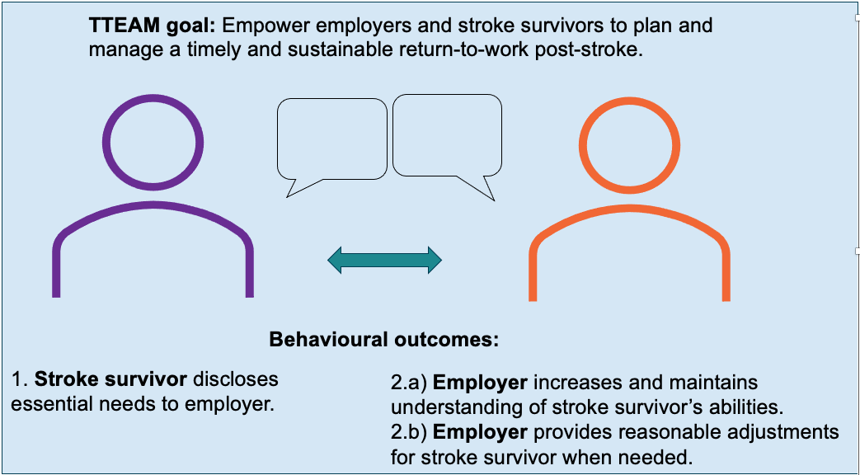
Overview of TTEAM

Slide 5
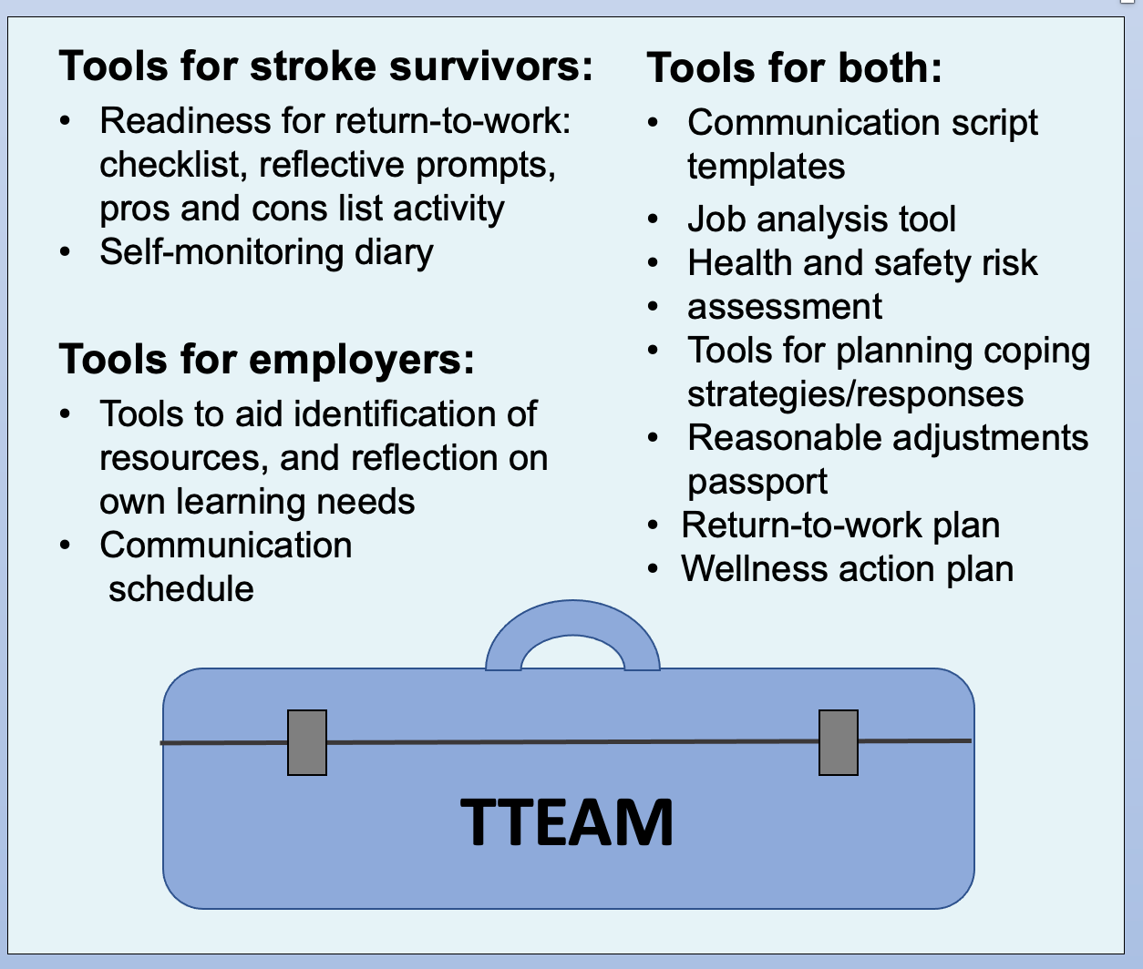
Tools included

Slide 6
Group discussion

Slide 7
Questions 1 and 2
Devices used to access TTEAM?
Prototype/s accessed?:
  Stroke survivor version
  Employer version
  Both

Slide 8
Question 3
Anything that was helpful when accessing and navigating TTEAM?

Slide 9
Question 4
Anything that made it difficult to access and navigate TTEAM?

Slide 10
Question 5
Anything about TTEAM that was useful for learning about
stroke and returning to work?

Slide 11
Question 7 (question 6 moved to end)
If you have an impairment/disability, was there anything you:
  liked about TTEAM (in relation to your needs)?
  did not like about TTEAM (in relation to your needs)?

Slide 12
Question 9 (question 8 moved to end)
Could anything be changed to improve TTEAM?

Slide 13
Question 10
How should people be made aware of
and gain access to TTEAM?

Slide 14
Final discussion (include questions 6 & 8)
Is there anything else you would like to say (or ask)?

Slide 15
Thank you!
kristelle.craven1@nottingham.ac.uk
@CravenKristelle

Slide 16
Disclaimer
This study is funded by the Ossie Newell Foundation (ONF) and the National Institute for Health and Care Research (NIHR) Applied Research Collaboration East Midlands (ARC EM). The views expressed are those of the authors and not necessarily those of the ONF, NIHR or the Department of Health and Social Care.

